Slide 1
Cells: Prokaryotes & Eukaryotes
Name

Slide 2
Goals of this Lesson
Goals of this lesson:
Learn that all of life is made up of two types of cells: prokaryotic cells and eukaryotic cells.
Understand the difference prokaryotic cells and eukaryotic cells.
Follow the instructions on each slide.

Slide 3
2 Types of Cells
There are two types of cells:
Prokaryotes - have no membrane bound nucleus, and no membrane bound organelles. Example: Bacteria cells are prokaryotes.
Eukaryotes - have a nucleus and membrane bound organelles. Example: Human cells, animal cells, fungi cells and protist cells are all eukaryotes.

Slide 4
“Prokaryote” Definition
Instructions: Look up the definition of “prokaryote”, type it here (include the url of your source):

Slide 5
The Prokaryotic Cell
Instructions:
Use google to search “prokaryotic cell”.
Examine the cells, pay special attention to the labeled cell parts.
Choose 3 that clearly label the DNA, copy and paste the three you have chosen to this slide (you may delete my instructions, or just paste the pictures over my instructions).

Slide 6
Prokaryotic DNA
What does the DNA in the prokaryotic cell look like?
Where is it located?

Slide 7
Prokaryotic Cell Structures
In addition to DNA, what other structures can be found on and in prokaryotic cells?

Slide 8
Flagellum on the Prokaryote
Many prokaryotic cells have a flagellum. What do you think the flagellum does?

Slide 9
“Eukaryote” Definition
Instructions: Look up the definition of “eukaryote”, type it here (include the url of your source):
Next: You do not have to find diagrams of eukaryotic cells, I did that for you. They are on the next slide. There is a diagram of an animal or human cell and a diagram of a plant cell. BOTH are eukaryotic cells.
Look at them and find the nucleus.

Slide 10
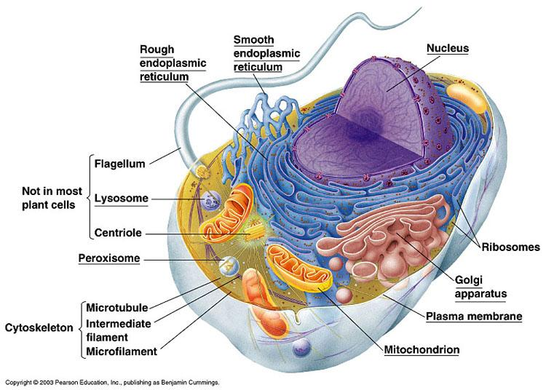
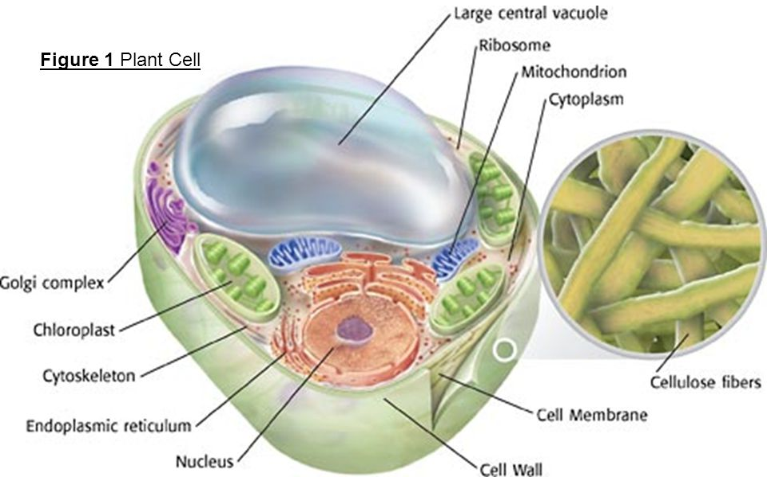
Eukaryotic Cells
Animal or Human Cell
Plant Cell

Slide 11
Find the Eukaryotic Nucleus
Instructions: Find the nucleus in both eukaryotic cells on the previous slide and draw a circle around them.
To draw a circle: Choose “insert”, then choose “line”, then choose “scribble”. Use your mouse or touchpad to draw the circle. You can practice on this slide.

Slide 12
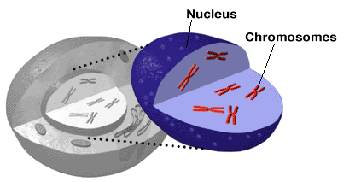
Nucleus of the Eukaryotic Cell
This is a close up look at the nucleus of a eukaryotic cell. Notice it contains chromosomes. Chromosomes are bundles of our DNA.
What does DNA look like in a eukaryotic cell?

Slide 13
Comparing Prokaryotic and Eukaryotic DNA
In your own words describe the difference between DNA found in a prokaryotic cell and the DNA found in a eukaryotic cell:

Slide 14
Similar Structures of Eukaryotic & Prokaryotic Cells
Observe the Prokaryotic and Eukaryotic diagrams. What structure(s) can you find in both? If you can’t find them by observing, you make look this information up.

Slide 15
Video Review
Watch this video (you may do this in groups).

Slide 16
Review
What are the two main types of cells?
Which contains DNA inside a nucleus?
What does DNA in a prokaryote look like?
Can both have a flagellum?
Do both have ribosomes?
Which has membrane bound organelles?

Slide 17
Turn it In!
Now, click turn it in :)
Have a great day!

