Slide 1
Skeletal System
Your Name

Slide 2
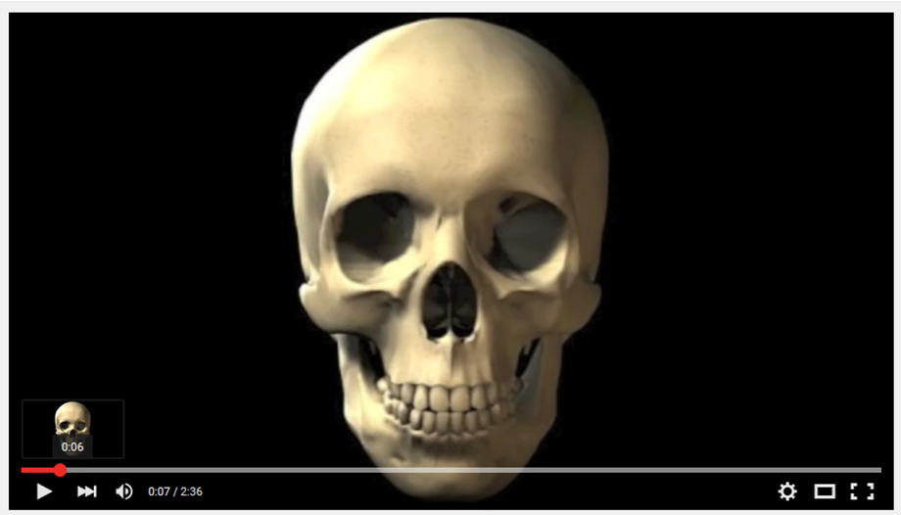
Here’s a little mood music to begin our new unit:
Click here to follow the link to the youtube video: https://www.youtube.com/watch?v=ja18CbJU6h8

Slide 3
Activity #1 - Label the Skeleton
Click the following link and complete the “Label the Skeleton” activity (you do not have to do the “Assemble the Skeleton Activity”).
http://media.abcya.com/games/skeletal_system/flash/skeletal_system.swf
You must repeat the activity until you are able to label the skeleton in less than 33 clicks. When you have done that, paste the end screen print here to verify your score (remember, it must be less than 33):
Instructions for pasting a screen print when using a Chromebook: 1. hold the ctrl key down, 2. click the button in the middle of the top row that has a square with two vertical lines to the right of it. 3. Click on “copy to clipboard” that appears in the lower right corner of your computer screen. Now you have made a screenshot. To paste it on this slide: 1. hold the ctrl key down, 2. click “v” and your screen will be pasted here.

Slide 4
Bone Fracture Project
A bone fracture is a break in the bone. There are several different types of fractures:
Greenstick
Fissured
Comminuted
Transverse
Oblique
Spiral
Follow the instructions on the slides that follow where you will show a picture, define and explain a possible cause for each fracture.
Use the internet to find the required information. Do not copy and paste the possible causes, please type in your own words.

Slide 5
Greenstick Fracture
Definition:
Possible Causes:
Include a photo.

Slide 6
Fissured Fracture
Definition:
Possible Causes:
Include a photo.

Slide 7
Comminuted Fracture
Definition:
Possible Causes:
Include a photo.

Slide 8
Transverse Fracture
Definition:
Possible Causes:
Include a photo.

Slide 9
Oblique Fracture
Definition:
Possible Causes:
Include a photo.

Slide 10
Spiral Fracture
Definition:
Possible Causes:
Include a photo.

Slide 11
Cells to Systems
Include a picture of a bone cell (osteocyte), bone tissue, a bone (that’s the organ for the skeletal system) and a skeletal system.

Slide 12
End of Assignment
If you enjoyed learning about fractures, you might be interested in the field of radiology.
This completes your e-learning assignment. Please click “turn-it-in” in Google Classroom.
Enjoy this beautiful day!
Mrs. Huth

