Slide 1
Skeletal System
Indiana Standard: 4
Notes:
Title
This unit covers Indiana State Standard 1: Cellular Chemistry.
_____

Slide 2
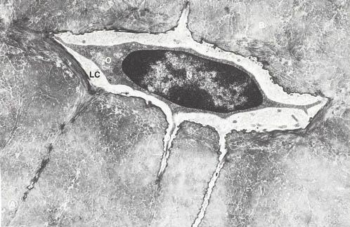
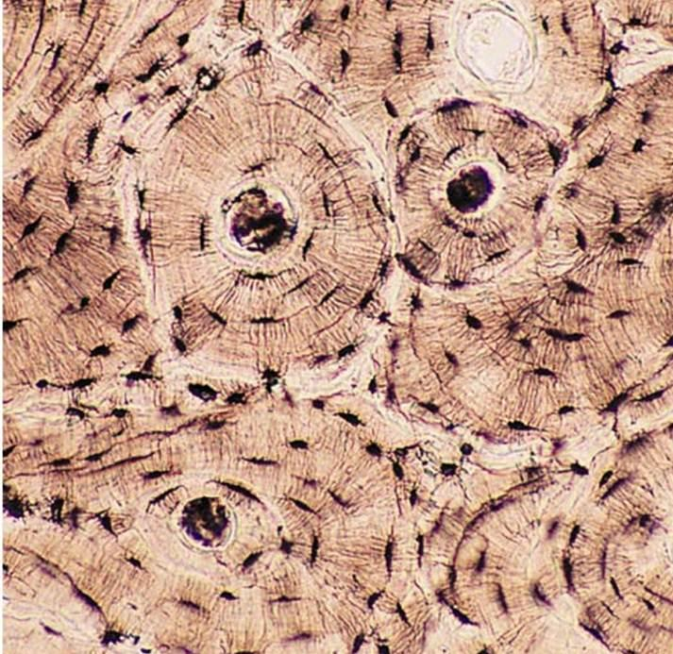
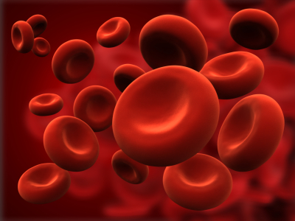
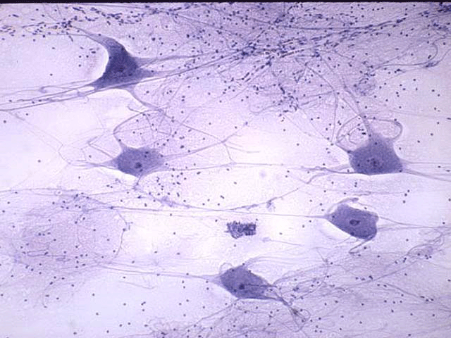
Osteocyte
7.1 Introduction
Bone Consists of Living Tissues
Cartilage
Blood
Dense Connective Tissue
Bone Tissue
Nervous Tissue
Notes:
_____

Slide 3
7.1 Introduction
Bones, Organs of the Skeletal System,
are Multifunctional:
Provide points of attachment
Protect and support softer tissues
House blood producing cells
Store inorganic salts
Form Passageways for blood vessels and nerves
Notes:
_____

Slide 4
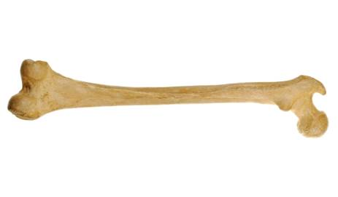
7.2 Bone Structure
Classification, According to Shape
Long Bones
Examples:
Forearm
Thigh bones
Notes:
_____

Slide 5
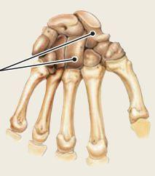
7.2 Bone Structure
Classification, According to Shape
Short Bones
Examples:
Wrists
Ankles
Notes:
_____

Slide 6
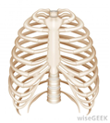
7.2 Bone Structure
Classification, According to Shape
Flat Bones
Examples:
Skull
Sternum
Ribs
Scapulae
Notes:
_____

Slide 7
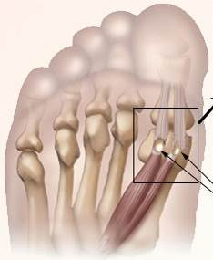
7.2 Bone Structure
Classification, According to Shape
Sesamoid Bones
Examples:
Patella (knee cap)
Ball of foot
Notes:
_____

Slide 8
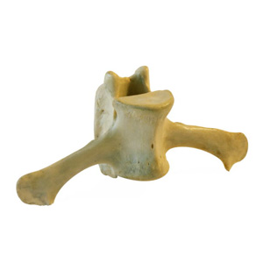
7.2 Bone Structure
Classification, According to Shape
Irregular Bones
Examples:
Vertebrae
Many facial bones
Notes:
_____

Slide 9
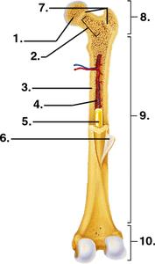
7.2 Bone Structure
Parts of a Long Bone
#8 Proximal Epiphysis
Structure: end closest to body
#10 Distal Epiphysis
Structure: end furthest from the body
Functions: articulates (forms
a joint) with another bone.
Notes:
_____

Slide 10
7.2 Bone Structure
Parts of a Long Bone
Articular Cartilage (not numbered)
Structure: coats the articulating portion of the epiphyses
Functions: protection
Notes:
_____

Slide 11
7.2 Bone Structure
Parts of a Long Bone
#9 Diaphysis
Structure: shaft between the epiphyses
Functions: surrounds and protects the medullary cavity
Notes:
_____

Slide 12
7.2 Bone Structure
Parts of a Long Bone
#6 Periosteum
Structure: tough vascular covering
Function: encloses bone, its fibers are continuous with connecting ligaments and tendons, helps form and repair bone tissue
Notes:
_____

Slide 13
7.2 Bone Structure
Parts of a Long Bone
#3 Compact Bone
Location: tightly packed tissue composing the walls of the diaphysis
Functions: provides strength
Notes:
_____

Slide 14
7.2 Bone Structure
Parts of a Long Bone
#1 Spongy Bone
Structure: made up of numerous branching plates called trabeculae, it fills the epiphyses
Functions: provides strength while reducing the bone’s weight
Notes:
_____

Slide 15
7.2 Bone Structure
Parts of a Long Bone
#4 Medullary Cavity
Structure: hollow chamber inside the diaphysis
Functions: houses marrow, nerves and blood vessels
Notes:
_____

Slide 16
7.2 Bone Structure
Parts of a Long Bone
Endosteum (not numbered)
Structure: lines the medullary cavity
Notes:
_____

Slide 17
Let’s Review Skeletal System Review
Kahoot
Notes:
Kahoot
Skeletal System #1 Review : https://play.kahoot.it/#/k/85b3a30c-9821-449e-855b-9666324a1ded
________

Slide 18
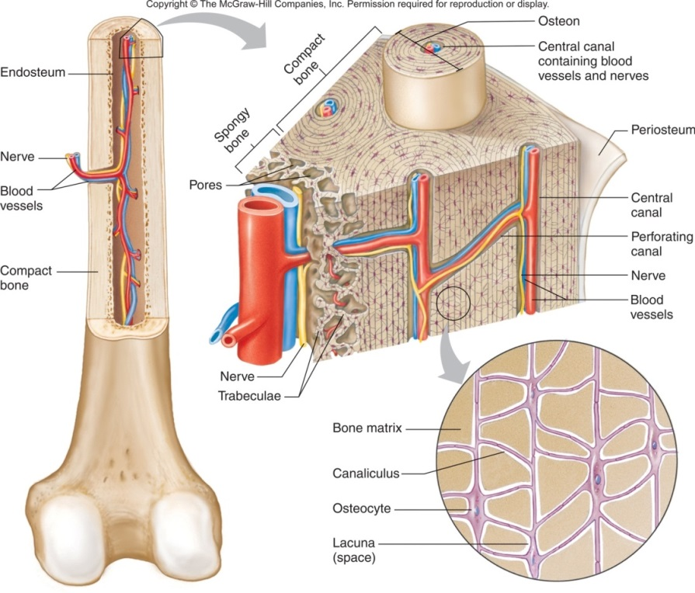
7.2 Bone Structure
Microscopic Structure
1. Compare and contrast compact and spongy bone
2. What gives bone its strength and resistance to crushing?
3. Where do nerve cells communicate?
Notes:
As we look at the microscopic structure of bone tissue, we are going to answer these questions.
_____

Slide 19
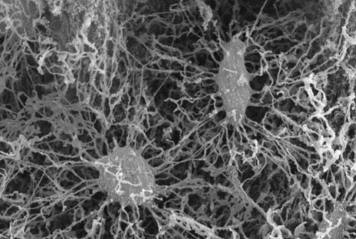
7.2 Bone Structure
Microscopic Structure
Both Compact
and Spongy Bone
Bone cells are called
osteocytes.
Notes:
_____

Slide 20
7.2 Bone Structure
Microscopic Structure
Both Compact
and Spongy Bone
The extracellular matrix of bone is composed of collagen and inorganic salts.
Notes:
_____

Slide 21
7.2 Bone Structure
Microscopic Structure
Both Compact
and Spongy Bone
Collagen gives bone its strength and resilience.
Notes:
_____

Slide 22
7.2 Bone Structure
Microscopic Structure
Both Compact
and Spongy Bone
Inorganic salts make it hard and resistant to crushing.
Notes:
_____

Slide 23
7.2 Bone Structure
Microscopic Structure
Compact Bone
Osteocytes and extracellular matrix form cylinders around central canals that run longitudinally and form units called osteon.
Notes:
_____

Slide 24
7.2 Bone Structure
Microscopic Structure
Compact Bone
Many of these cemented together form compact bone.
Notes:
_____

Slide 25
7.2 Bone Structure
Microscopic Structure
Compact Bone
Each central canal contains blood vessels and nerve fibers surrounded by loose connective tissue.
Notes:
_____

Slide 26
7.2 Bone Structure
Microscopic Structure
Compact Bone
Perforating canals run transversely connecting the central canals.
Notes:
_____

Slide 27
7.2 Bone Structure
Microscopic Structure
Compact Bone
The blood in these vessels nourishes the bone. The nerve cells communicate throughout the structure.
Notes:
_____

Slide 28
7.2 Bone Structure
Microscopic Structure
Spongy Bone
Osteocytes and extracellular matrix do not form around central canals.
Notes:
_____

Slide 29
7.2 Bone Structure
Microscopic Structure
Spongy Bone
Instead, they lie within trabeculae and get nutrients from substances that diffuse into the canaliculi.
Notes:
_____

Slide 30
Notes:
Guide students through information on page 134 in textbook while reviewing the diagram.
_____

Slide 31
7.3, 7.4, 7.5 and 7.13
See work packet and text book for the sections assigned above.
Notes:
As we look at the microscopic structure of bone tissue, we are going to answer these questions.
_____

