Slide 1
Science What is Science?
?
Biology is a Branch of
Notes:
What is Science?
Take a couple minutes to talk with your lab group, and jot down a few ideas to answer the question, “what is science”?
_____

Slide 2
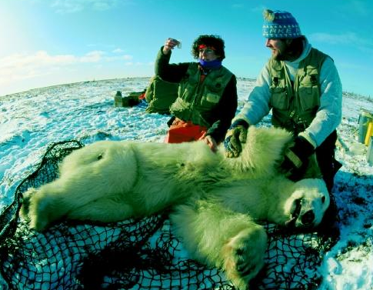
Science
Defined
Science is an organized way
of gathering
and analyzing evidence in the natural world.
Notes:
What is Science?
Science is an organized way of gathering and analyzing evidence in the natural world.
This is a photograph of Wildlife Biologists taking samples from a drugged polar bear. They are testing the polar bear for pesticides.
Photo: http://www.biologyreference.com/Ve-Z/Wildlife-Biologist.html
_____

Slide 3
Scientific Method
Organized Process
The “scientific method” is the organized process in which scientists gather, test and report information.
Notes:
Scientific Method
The scientific method is the organized process in which scientists gather, test and report information.
_____

Slide 4
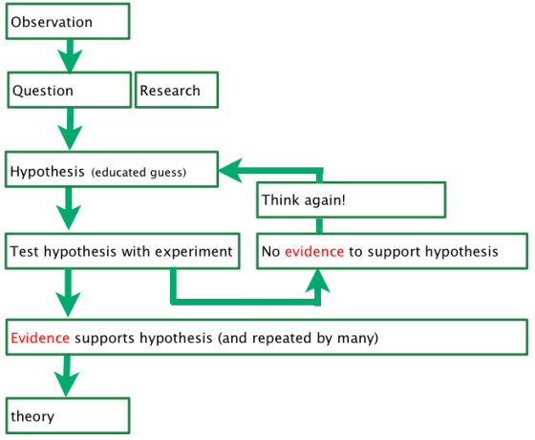
Scientific Method
Organized Process
Notes:
Scientific Method
Scientists are always observing their surroundings.
_____

Slide 5
Scientific Method
Organized Process
Notes:
Scientific Method
Sometimes these observations lead to questions, like: Why do marsh grasses grow taller in some places than others? These questions lead to research.
Photo: https://bdcaecology.wordpress.com/2013/09/15/1-3/
_____

Slide 6
Scientific Method
Organized Process
Notes:
Scientific Method
Then scientists use the information they know to form a hypothesis.
Photo: https://bdcaecology.wordpress.com/2013/09/15/1-3/
_____

Slide 7
Scientific Method
Organized Process
Hypothesis
Scientific explanation
for a set of observations that
can be tested.
Sometimes called an “if, then” statement.
Notes:
Scientific Method
A hypothesis is a scientific explanation for a set of observations that can be tested.
Photo: https://bdcaecology.wordpress.com/2013/09/15/1-3/
_____

Slide 8
Scientific Method
Organized Process
More Nitrogen?
Notes:
Scientific Method
For example: if nitrogen added to the soil, then marsh grass growth will increase.
Photo: https://bdcaecology.wordpress.com/2013/09/15/1-3/
_____

Slide 9
Let’s Explore What’s in the Bag?
LAB
Notes:
Follow instructions in work packet. When complete, share findings as a group. Students should determine if peer findings are reasonable. Do not share the contents of the bags at this time. Explain that many times in science the truth remains unknown.
Inspired by: http://www.indiana.edu/~ensiweb/lessons/mys.box.html

Slide 10
Scientific Method
Organized Process
Notes:
Scientific Method
Next scientists design a controlled experiment to test their hypothesis. First, scientists are careful to make sure all conditions are the same for both the control group and the experimental group.
Photo: https://bdcaecology.wordpress.com/2013/09/15/1-3/
_____

Slide 11
Controlled Experiment
Controlled Experiment
Experiment
in which only
one variable
is changed.

Slide 12
Controlled Experiment
Constants
Conditions
that do not change in an experiment.

Slide 13
Controlled Experiment
Control
Group
The group in which no changes are made.

Slide 14
Controlled Experiment
Experimental Group
Group in which an independent variable is introduced.

Slide 15
Controlled Experiment
Independent Variable
Condition
that is manipulated
or changed
in an experiment.

Slide 16
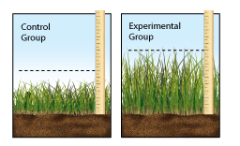
Controlled Experiment
Dependent Variable
Variable that changes as the result of independent variables.

Slide 17
Controlled Experiment
Dependent Variable
Remember changes in the dependent variable “depend” on the independent variable.

Slide 18
Scientific Method
Science is a Process
Notes:
Scientific Method
Then, scientists add an independent variable, in this case nitrogen, to the experimental group. They do not make any changes to the control group.
Photo: https://bdcaecology.wordpress.com/2013/09/15/1-3/
_____

Slide 19
Scientific Method
Science is a Process
Data is Collected & Recorded
Notes:
Scientific Method
Scientists carefully collect and record data during the experiment. During this time they watch for a change in the dependent variable.
Photo: https://bdcaecology.wordpress.com/2013/09/15/1-3/
_____

Slide 20
Scientific Method
Science is a Process
Notes:
Scientific Method
Data either supports, or does not support the hypothesis. If data does not support the hypothesis, scientists develop a new hypothesis test the new hypothesis. Either way, scientists report their findings for peer review by other scientists.
In this experiment, the evidence does support the hypothesis “If nitrogen is added to the soil, then marsh grass will experience an increased growth rate”.
Photo: https://bdcaecology.wordpress.com/2013/09/15/1-3/
_____

Slide 21
Peer Review Why is it Important?
?
Notes:
Why is Peer Review Important?
Refer to work packet to read “Peer Review”
Answer question at bottom of the page: “What could happen if scientific findings did not go through the process of peer review”?
_____

Slide 22
Scientific Method
Science is a Process
Notes:
Scientific Method
Over time, many scientists may test the same hypothesis over and over, in addition to other observations and hypothesis. This allows them to develop theories. Theories must be accepted by a wide range of scientists, however they do change and are replaced when new evidence is found.
Photo: https://bdcaecology.wordpress.com/2013/09/15/1-3/
_____

Slide 23
Scientific Method
Science is a Process
Theory
A theory is a well-tested explanation that accounts for a
lot of observations
and hypotheses.
Notes:
Scientific Method
A theory is a well tested explanation that accounts for a lot of observations and hypotheses.
_____

Slide 24
Let’s Practice ISTEP+ Questions
PRACTICE
Notes:
Practice
Complete ISTEP+ practice questions in work packet.
__________

Slide 25
Let’s Explore The Controlled Experiment
LAB
Notes:
Title
Now, it’s your turn to explore the Scientific Method. Refer to your Work Packet, and find the “Sprouting Potato Lab”.
__________

Slide 26
Cross Contamination … What Do You Think Of?
?
Notes:
Cross Contamination
What do you think of when you hear “cross contamination?”
_____

Slide 27
Cross Contamination
Notes:
Bats: https://www.youtube.com/watch?v=MQtrDxJRhOU
Infor about white-nose syndrome at Mammoth Cave in Kentucky: https://www.nps.gov/maca/whitenose.htm
_____

Slide 28
Cross Contamination
Notes:
Ebola: https://www.youtube.com/watch?v=XCrOde-JYs0
Published on Jun 26, 2015
Produced by Global Health Media Project in collaboration with the International Federation of Red Cross and Red Crescent Societies, UNICEF, and Yoni Goodman. Download link: http://globalhealthmedia.org/videos/
_____

Slide 29
New Discoveries
Lead to Re-evaluation
New Discoveries often lead to a
re-evaluation of previously accepted scientific knowledge.
Notes:
New Discoveries
Let’s pretend modern technology has allowed you to see through the bottom of the seven bags you observed.
_____

Slide 30
New Info about Zika Virus
February 2016
Notes:
https://www.youtube.com/watch?v=2AGtAypf80E
Zika and Microcephaly
_____

Slide 31
New Discoveries Guide Social and Environmental Decisions
Notes:
https://www.youtube.com/watch?v=sFTfkuae8lM
_____

Slide 32
New Discoveries
Guide Medical Decisions
Notes:
https://www.youtube.com/watch?v=bGtEZRUwdmY
_____

Slide 33
End of Unit
Notes:
End of Unit
This concludes the Introduction to Science Unit.
_____

Slide 34
References
Indiana Department of Education. (2010). Standards. Retrieved from Indiana Department of Education: http://www.doe.in.gov/sites/default/files/standards/science/2010-Science-BiologyI.pdf
Kenneth R Miller and Joseph S. Levine. (2010). Biology. Upper Saddle River, New Jersey: Pearson Education, Inc.
Notes:
References
_____

