Slide 1
Molecular Basis of Heredity
Indiana Standard: 5
Notes:
Molecular Basis of Heredity
_______

Slide 2
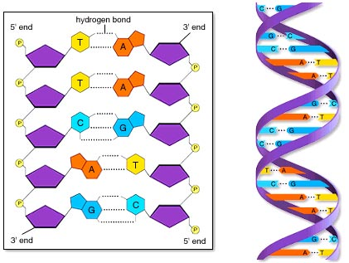
Molecular Basis of Heredity
DNA =Deoxyribonucleic Acid
DNA Structure
Made up of 3 part nucleotides:
A Sugar
A Phosphate
One of theses Nitrogen Bases:
Adenine
Thymine
Cytosine
Guanine
Notes:
DNA Structure
Made up of Nucleotides containing
Sugar
Phosphate
Nitrogen Bases
Adenine
Thymine
Cytosine
Guanine

Slide 3
Molecular Basis of Heredity
DNA =Deoxyribonucleic Acid
DNA Structure
Nucleotides assemble forming a double helix structure.
Notes:
DNA Structure
Made up of Nucleotides containing
Sugar
Phosphate
Nitrogen Bases
Adenine
Thymine
Cytosine
Guanine

Slide 4
Molecular Basis of Heredity
DNA
DNA Structure
Base Pairing Rules:
Adenine and Thymine always pair (A&T)
Guanine and Cytosine always pair (C&G)
Notes:
DNA Replication
Base Pairing Rules:
A and T always pair (adenine and thymine)
G and C always pair (guanine and cytosine)
_____

Slide 5
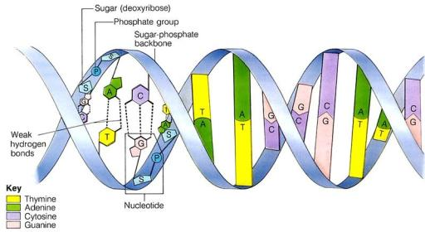
Molecular Basis of Heredity
DNA
DNA Function
Contains your blueprint
“Genome” = all of your DNA
“Gene” = one set of instructions within your DNA
Notes:
DNA Function
Blueprint and instructions to make you
Genome = all of your DNA
Gene = one set of instructions within your DNA
_____

Slide 6
The Animated Genome
Notes:
Instructions: Complete guided notes in work packet to accompany this video.
Genome, Unlocking Life’s Code Video: https://unlockinglifescode.org/media/animations/659#660

Slide 7
Molecular Basis of Heredity
Cell Cycle Review
Notes:
Teacher’s Pet Cell Cycle
https://www.youtube.com/watch?v=WaJ8epyEx2Q

Slide 8
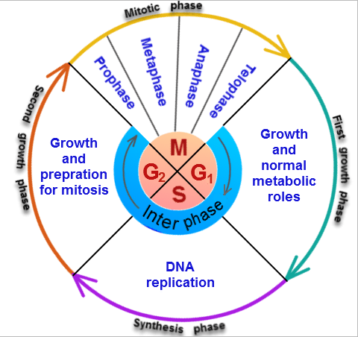
Molecular Basis of Heredity
DNA
DNA Replication
DNA Replication takes place during interphase.
Purpose: replication of the DNA that was divided during anaphase.
Notes:
DNA Replication
Takes place during the Synthesis phase (“S” Phase of the cell cycle)
Purpose: replication of the chromatid that was pulled in half during anaphase
_____

Slide 9
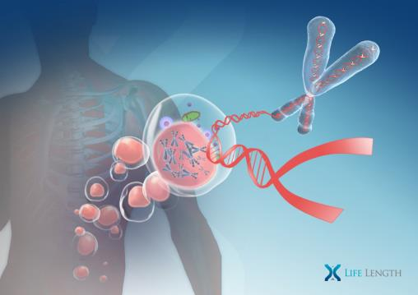
Molecular Basis of Heredity
DNA
DNA Replication
Takes place in the nucleus of the cell
Notes:
DNA Replication
Takes place in the nucleus of the cell.
_____

Slide 10
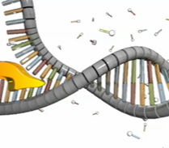
Molecular Basis of Heredity
DNA
DNA Replication
Enzymes play a crucial roll
DNA Helicase separates strands of DNA by breaking bonds between the bases.
Think of a helicopter blade!
Notes:
DNA Replication
Enzymes play a crucial roll
Helicase separates strands of DNA by breaking Hydrogen Bonds
_____

Slide 11
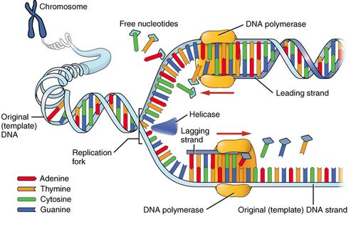
Molecular Basis of Heredity
DNA
DNA Replication
DNA polymerase builds bonds between the free floating nucleotides and the DNA strand
Ligase binds the base pairs
Notes:
DNA Replication
Enzymes play a crucial roll
DNA polymerase builds bonds between the free floating nucleotides and the DNA strand.
Reminder DNA polymerase is bonding the adenine and thymine bases and the cytosine and guanine bases.

Slide 12
Notes:
DNA Replication

Slide 13
Let’s Explore DNA Replication
Illustrate
Notes:
Lab
Illustrate DNA Replication in the nucleus.
_______

Slide 14
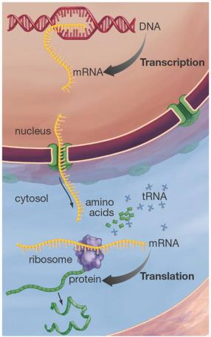
Molecular Basis of Heredity
Protein Synthesis
Protein Synthesis
1. Transcription to mRNA
2. Translation to Proteins
mRNA = Messenger RNA
RNA = Ribonucleic Acid
Notes:
DNA to Proteins
Teacher’s Pet Video about Protein Synthesis: https://www.youtube.com/watch?v=2zAGAmTkZNY
We have been talking about DNA replication, but cellular reproduction doesn’t stop there. The reproduction of cells requires the Protein Synthesis, in other words, the cell needs to make proteins for cells to reproduce. There are two important steps involved in this process:
Steps from DNA to Proteins
1. Transcription to Messenger RNA or mRNA
2. Translation to proteins
mRNA = Messenger RNA
RNA = Ribonucleic Acid
______________

Slide 15
Molecular Basis of Heredity
Protein Synthesis
Protein Synthesis
1. Transcription to mRNA
2. Translation to Proteins
mRNA = Messenger RNA
RNA = Ribonucleic Acid
Notes:
DNA to Proteins
Teacher’s Pet Video about Protein Synthesis: https://www.youtube.com/watch?v=2zAGAmTkZNY
We have been talking about DNA replication, but cellular reproduction doesn’t stop there. The reproduction of cells requires the Protein Synthesis, in other words, the cell needs to make proteins for cells to reproduce. There are two important steps involved in this process:
Steps from DNA to Proteins
1. Transcription to Messenger RNA or mRNA
2. Translation to proteins
mRNA = Messenger RNA
RNA = Ribonucleic Acid
______________

Slide 16
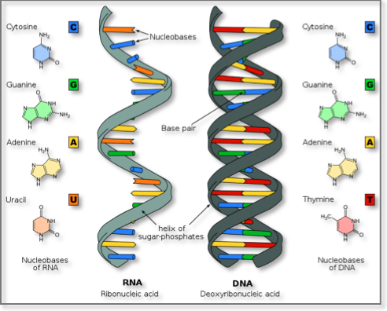
Molecular Basis of Heredity
DNA to Proteins
RNA Structure
Helix instead of double helix
Uracil instead of thymine
The sugar is ribose instead of deoxyribose
Notes:
DNA to Proteins
Teacher’s Pet Video about Protein Synthesis: https://www.youtube.com/watch?v=2zAGAmTkZNY
We have been talking about DNA replication, but cellular reproduction doesn’t stop there. The reproduction of cells requires the Protein Synthesis, in other words, the cell needs to make proteins for cells to reproduce. There are two important steps involved in this process:
Steps from DNA to Proteins
1. Transcription to Messenger RNA or mRNA
2. Translation to proteins
mRNA = Messenger RNA
RNA = Ribonucleic Acid
______________

Slide 18
Molecular Basis of Heredity
mRNA & Transcription
Transcription to mRNA
Takes place during Interphase of the cell cycle.
Purpose: Transcribe DNA into a message the ribosome can read & deliver the message to the ribosome.
Think: Genes are going to the factory to be assembled into us.
Notes:
mRNA Transcription
Takes place during the G2 phase of Interphase.
Purpose: Transcribe DNA into a message the ribosome can read & deliver the message to the ribosome.
Think: genes are going to the factory to be assembled into us.
_____

Slide 19
Molecular Basis of Heredity
mRNA & Transcription
Transcription to mRNA
Occurs inside the nucleus
Similar to DNA replication
Thymine is replaced with Uracil
Base pairing rules:
G & C pair; A & U pair
RNA polymerase is the synthesizing enzyme
Notes:
mRNA Transcription
Occurs inside the nucleus
Similar to DNA replication
Thymine is replaced with Uracil
Base pairing rules: G pairs with C, A pairs with U
RNA polymerase is the synthesizing enzyme
_________

Slide 20
Molecular Basis of Heredity
mRNA & Transcription
Transcription to mRNA
Summary: Ribosomes read the genetic code in DNA, however ribosomes can’t read the “Thymine” base, so Thymine is replaced with “Uracil” in a strand of mRNA. Then the message is taken from the nucleus to the ribosome by mRNA.
Notes:
Transcription to mRNA
Summary: Ribosomes read the genetic code in DNA, however ribosomes can’t read the “Thymine” base, so Thymine is replaced with “Uracil” in a strand of mRNA. Then the message is taken from the nucleus to the ribosome by mRNA.
_________________

Slide 21
Let’s Explore mRNA Transcription
Illustrate
Notes:
Lab
Illustrate mRNA transcription in the nucleus.
_______

Slide 23
Practice Transcription
Notes:
Practice Transcription: Activity Instructions: 1. It is not necessary to read the article on the left of the activity. 2. Pair the bases according to the mRNA base pairing rules.
3. Click on “show labels” when the activity is complete to identify all components of the activity
http://www.glencoe.com/sites/common_assets/science/virtual_labs/LS04/LS04.html ________

Slide 24
Molecular Basis of Heredity
Translation
Translation to Protein
Takes place during the G2 phase of Interphase.
Purpose: Decode the message delivered by the mRNA strand to make a protein from amino acids.
Think: Factory is assembling us from instructions in our genes.
Notes:
Translation to Protein
Takes place during the G2 phase of Interphase.
Purpose: Decode the message delivered by the mRNA strand to make a protein from amino acids.
Think: Factory is assembling us from instructions in our genes.
_____

Slide 25
Molecular Basis of Heredity
Translation
Translation
mRNA travels from nucleus to Ribosome subunits
Translation occurs at the site of the ribosome.
Ribosome subunits read mRNA and signal tRNA to transfer amino acids to the active site.
tRNA = Transfer RNA
Notes:
Translation
mRNA travels out of the nucleus, through the cytoplasm, to the ribosome subunits
Translation occurs in the cytoplasm
Ribosome subunits read mRNA strand and signal tRNA to transfer amino acids to the active site
tRNA = Transfer RNA
___________________

Slide 26
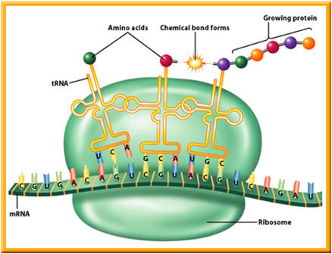
Molecular Basis of Heredity
Translation
Translation
Triplicates in the mRNA strand, called “codons” code for specific amino acids.
tRNA “anti-codons” pair with the codons .
tRNA base pairing rules: A&U; C&G pair.
Anti-codon
Codon
Notes:
Translation
Triplicates in the mRNA strand, called “codons” code for specific amino acids
tRNA “anti-codons” pair with the codons
mRNA base pairing rules are followed (A and U pair; C and G pair)
___________________

Slide 27
Molecular Basis of Heredity
Translation
Translation
Amino acids transferred by tRNA bond forming a protein.
Reflect: amino acids
Notes:
Translation
Amino acids transferred by the tRNA bond forming a protein.
Reflect: amino acids = one of the carbon compounds
amino acids = building blocks of life
Proteins = make up most of what we are
___________________

Slide 28
Molecular Basis of Heredity
Translation
Translation
“Start” and “stop” codons mark the beginning and end of each gene.
Notes:
Translation
“Stop” and “Start” codons mark the beginning and end of each gene.
___________________

Slide 29
Molecular Basis of Heredity
Translation
Translation
“Start” and “stop” codons mark the beginning and end of each gene.
Notes:
Translation
“Stop” and “Start” codons mark the beginning and end of each gene.
___________________

Slide 30
DNA to Protein Video
Notes:
Video Re-cap and Preview of Translation:
This video re-caps what you have learned thus far, and gives a preview of what we will learn today.
From DNA to Protein Video: https://www.youtube.com/watch?v=gG7uCskUOrA _______________

Slide 31
Let’s Explore Translation
LAB
Notes:
Lab
Illustrate translation in the cytoplasm between the ribosome sub units.
_______

Slide 32
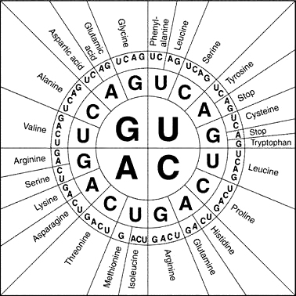
Notes:
Practice Translation:
Sometimes amino acids are decoded with a wheel. This wheel corresponds to the translation exercise in the work packet. Practice decoding with the wheel. _________

Slide 33
Practice Translation
Notes:
Practice Translation:
http://learn.genetics.utah.edu/content/basics/transcribe/ ______

Slide 34
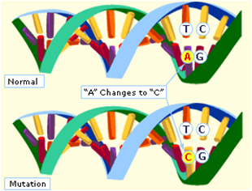
Molecular Basis of Heredity
Mutations
Genetic Mutations
Changes in organism’s DNA
Sometimes harmful
Sometimes helpful
Notes:
Genetic Mutations: Change in organism’s DNA _____

Slide 35
Top 8 Amazing Genetic Mutations
Notes:
The List Bomb Top 8 Amazing Genetic Mutations – 5:08 minutes
https://www.youtube.com/watch?v=9S_ZrkkdSa0

Slide 36
Molecular Basis of Heredity
Mutations
Causes of Mutations:
Errors in DNA replication
Errors during crossing over in meiosis
Environmental factors, these are called “mutagens”
Notes:
Causes of Mutations:
Errors in DNA replication
Errors during crossing over in meiosis
Environmental factors
_____

Slide 37
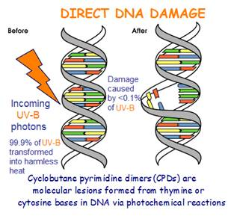

Slide 38
Molecular Basis of Heredity
Mutations
Heritable Mutations:
Mutations to gametes can be inherited
Mutations to somatic cells can not inherited
Notes:
Causes of Mutations:
Errors in DNA replication
Errors during crossing over in meiosis
Environmental factors
_____

Slide 39
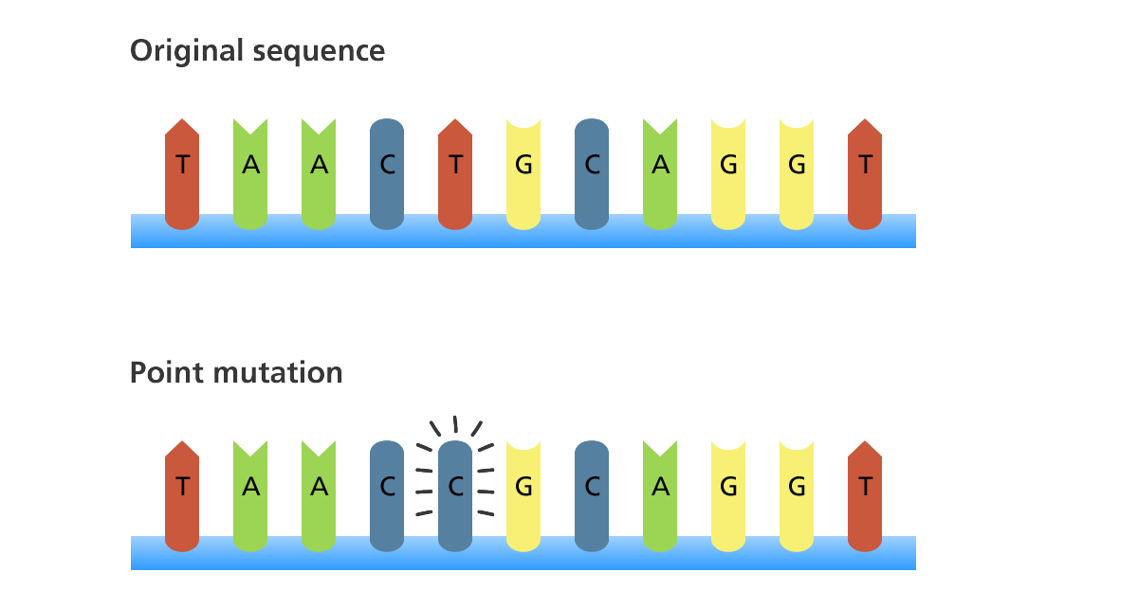
Molecular Basis of Heredity
Mutations
Point Mutation:
One base changes
Usually occurs during DNA replication
Usually corrected by DNA polymerase
Might code for same amino acid and go unnoticed
Notes:
Point Mutation
One base changes
Usually occurs during DNA replication
Usually corrected by DNA polymerase
_____

Slide 40
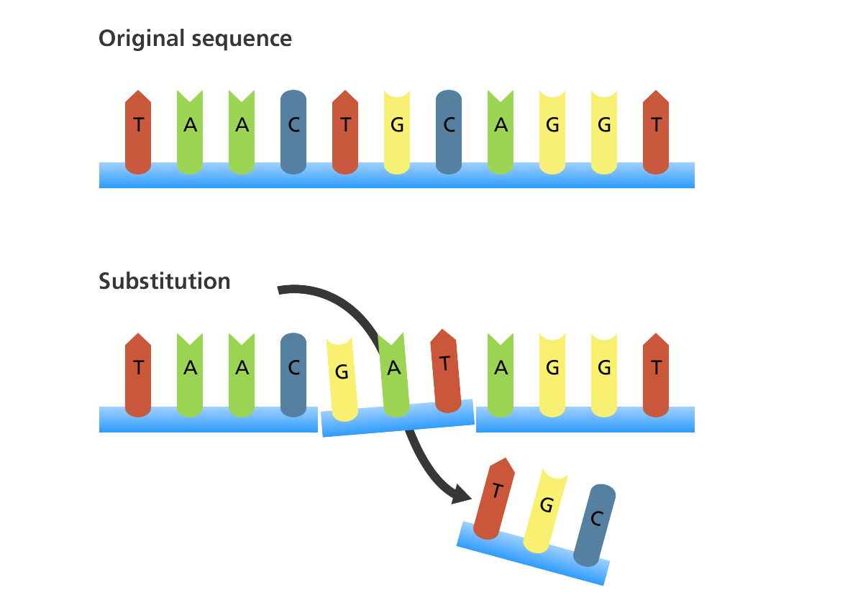
Molecular Basis of Heredity
Mutations
Substitution:
Similar to point mutation affecting more than one base
Notes:
Point Mutation
One base changes
Usually occurs during DNA replication
Usually corrected by DNA polymerase
_____

Slide 41
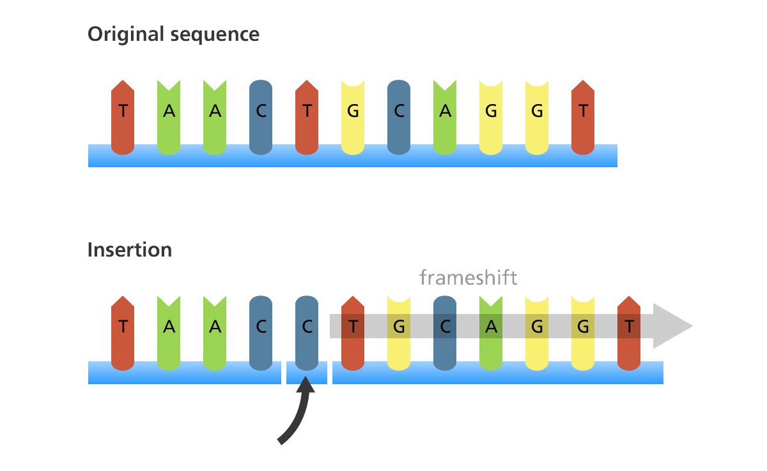
Molecular Basis of Heredity
Mutations
Frame Shift:
Base is inserted or deleted causing a shift in strand of DNA.
Notes:
Frame Shift Mutation:
Base is inserted or deleted causing a shift in strand of DNA
_____

Slide 42
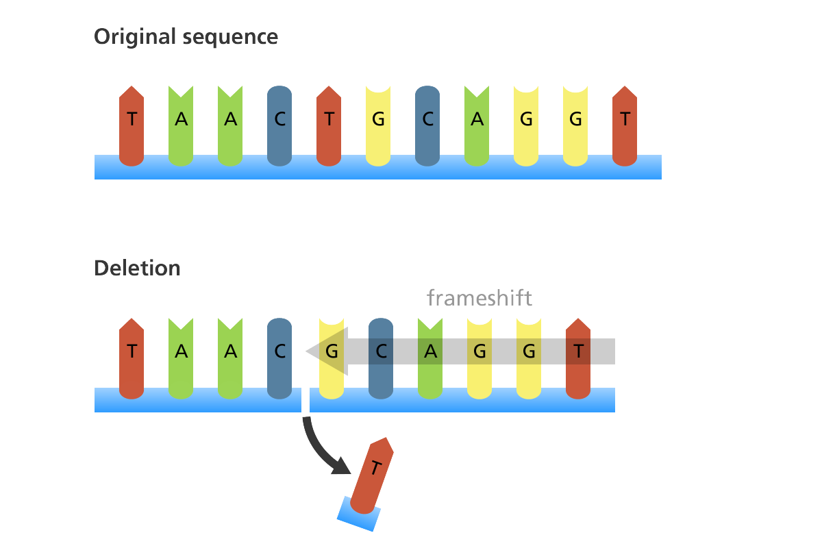
Molecular Basis of Heredity
Mutations
Frame Shift:
Serious mutation that changes the resulting protein
Notes:
Frame Shift Mutation:
Base is inserted or deleted causing a shift in strand of DNA
_____

Slide 43
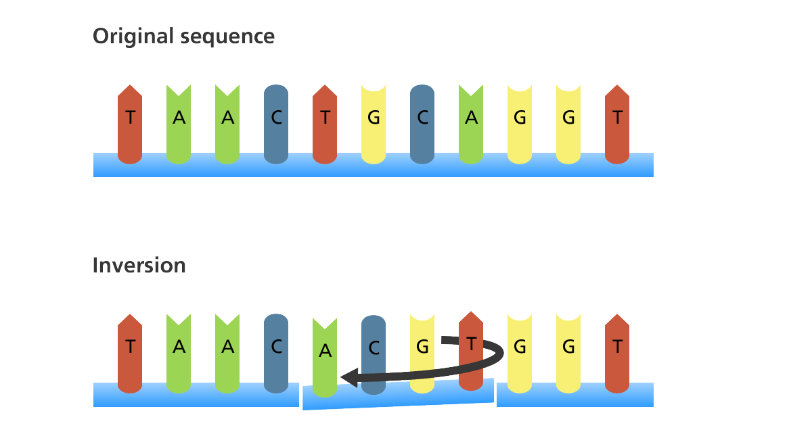
Molecular Basis of Heredity
Mutations
Inversion:
Segment of DNA inverts 180 degrees
Notes:
Frame Shift Mutation:
Base is inserted or deleted causing a shift in strand of DNA
_____

Slide 44
Mutations, Bozeman Science (7:02)
Notes:
Mutation Video, Bozeman Science:
https://www.youtube.com/watch?v=eDbK0cxKKsk
______

Slide 45
Let’s Explore Mutations
LAB
Notes:
Lab
Lost in translation Bee Lab: http://www.genomebc.ca/education/teachers/activities/lost-in-translation/
_______

Slide 46
end

