Slide 1
Genetics
Indiana Standard: 7
Notes:
Genetics
_______

Slide 2
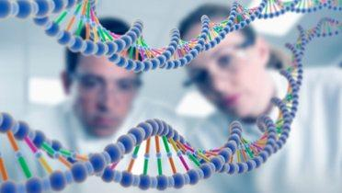
Genetics
Genetics Defined
Genetics
Study of passing traits to offspring
Notes:
Genetics: study of passing traits to offspring
_____

Slide 3
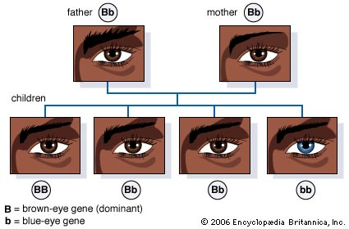
Genetics
Traits & Alleles
Traits
Characteristics that are inherited
Notes:
Traits: Characteristics that are inherited.
_____

Slide 4
Genetics
Traits & Alleles
Allele
Scientific description of a trait
1 inherited from each parent
Notes:
Allele
Scientific description of a trait
1 inherited from each parent
_____

Slide 5
Genetics
Traits & Alleles
Genotype
Allele combination for the trait
Phenotype
Outward appearance of the allele combination
Notes:
Genotype: Allele combination for the trait
Phenotype: Outward appearance of the allele combination
_____

Slide 6
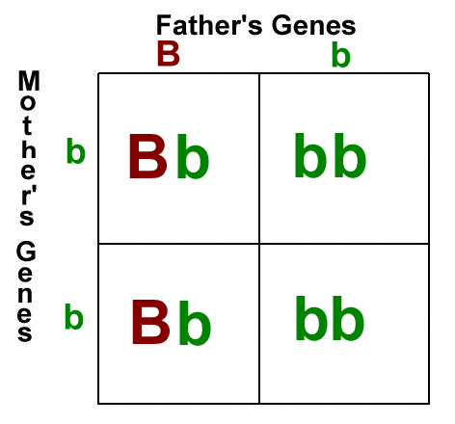
Genetics
Traits & Alleles
Homozygous
Two alleles of a gene are the same
Heterozygous
Two alleles of a gene are different
Notes:
Homozygous: Two alleles of a gene are the same
Heterozygous: Two alleles of a gene are different
_____

Slide 7
Genetics
Traits & Alleles
Dominant - Capitalized
Trait is expressed if a dominant allele is present
“it dominates!”
Recessive – Lower Case
Trait is only expressed when there are two recessive alleles
Notes:
Dominant: Trait is expressed if a dominant allele is present, it trumps the other allele
Recessive: Trait is expressed when there are two recessive alleles
_____

Slide 8
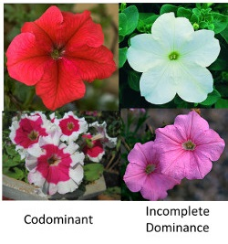
Genetics
Traits & Alleles
Co-dominance
Both traits are visible
Incomplete Dominance
Neither trait dominates the other
Notes:
Co-dominance: Both traits are visible
Incomplete Dominance: Neither trait dominates the other
_____

Slide 9
Gregor Mendel, Father of Genetics
Notes:
Gregor Mendel: Father of Genetics
https://www.youtube.com/watch?v=cWt1RFnWNzk
_____

Slide 10
What are Traits?
Notes:
What are Traits?
http://learn.genetics.utah.edu/content/inheritance/traits/
Watch this short presentation and answer corresponding questions in work packet
_____________

Slide 11
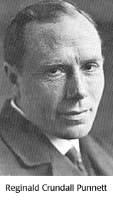
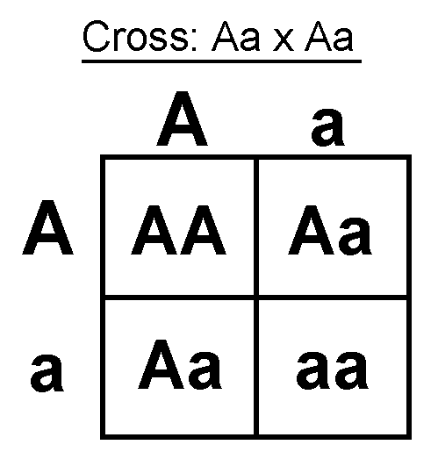
Genetics
Traits & Probability
Punnett Square
Grid system for predicting all possible genotypes resulting from a cross
Reginald Punnett, early 1900’s
Notes:
Punnett Square: Grid system for predicting all possible genotypes resulting from a cross - Reginald Punnett, Early 1900’s
_____

Slide 12
Genetics
Traits & Probability
Probability
Probability is the likelihood, or chance that a particular event will happen.
Notes:
Probability: Likelihood, or chance that a particular event will happen.
_____

Slide 13
Genetics
Traits & Probability
Probability
Probability =
number of ways an event can occur / number of total possible outcomes
Notes:
Probability = number of ways an event can occur / number of possible outcomes
_____

Slide 14
Genetics
Traits & Probability
Probability
Q: What is the probability of AA offspring from this cross?
A: ¼ = 25%
Notes:
Question: What is the probability of an AA offspring from this cross?
Answer; ¼ = 25%
_____

Slide 15
Punnett Square
Notes:
Punnett Squares
Video: https://www.youtube.com/watch?v=V_pl5lcSUFg
____

Slide 16
A A
a
a

Slide 17
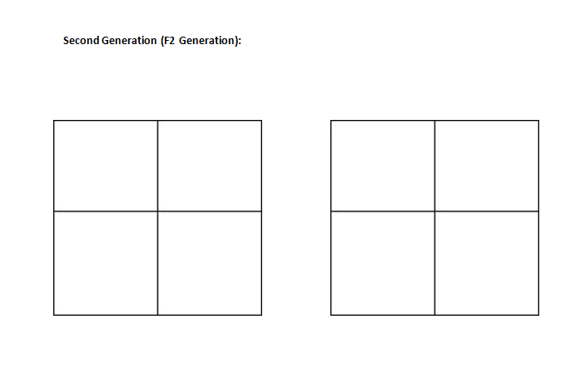

Slide 18
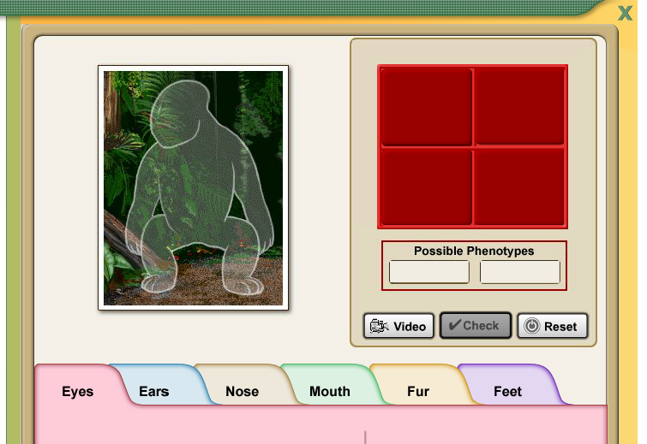
Punnett Square Practice
Notes:
Punnett Squares
Digital Assignment in Google Classroom
Review: Model on the whiteboard. Check for understanding for the following: phenotype, genotype, allele, dominant, recessive, homozygous and heterozygous.
Activity: http://www.glencoe.com/sites/common_assets/science/virtual_labs/E09/E09.html
___

Slide 19
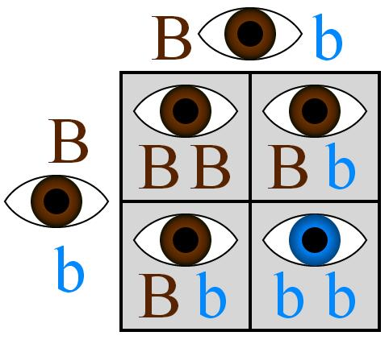
Probability of blue eyes?
Notes:
Probability of blue eyes?

Slide 20
Probability of brown eyes?
Notes:
Probability of brown eyes?

Slide 21
Probability of Homozygous Dominant?
Notes:
Probability of homozygous dominant?

Slide 22
Probability of Heterozygous Dominant?
Notes:
Probability of heterozygous dominant?

Slide 23
Exit Ticket Punnett Squares
EXIT
Notes:
Exit Ticket
Complete the “Punnett Squares” Exit Ticket in Google Classroom.
___

Slide 24
Punnett Square
Notes:
Punnett Squares
Video: https://www.youtube.com/watch?v=V_pl5lcSUFg
____

Slide 25
Pedigree Charts
Notes:
Punnett Squares
Video: https://www.youtube.com/watch?v=Wuk0W10EveU&t=18s
____

Slide 26
Additional Resources
Notes:
Additional Resources:
Many Punnett square activities: http://comelearnmore.com/websites-by-topic/genetics-games/
Alien Babies: http://www.genomebc.ca/education/teachers/activities/alien-babies/
Movie - Gattaca
Intro to Genetics Trailer
https://www.youtube.com/watch?v=UEKS4w9bfJg&list=PLISBHwlJXpn2bmLjfiShKcIHpBPcov24O&index=9
Website with neat activities: http://www.genomebc.ca/education/teachers/activities/alien-babies/
__________

