Slide 1
Living Things
Share Characteristics
Made of Cells
Maintain Homeostasis
Respond to Stimuli
Obtain & Use Energy - “Metabolism”
Reproduce
Grow and Develop
Adapt to Surroundings
Notes:
Characteristics of Living Things
Made of Cells
Maintain Homeostasis
Respond to Stimuli
Obtain & Use Energy - “Metabolism”
Reproduce
Grow and Develop
Adapt to Surroundings
Throughout the semester we will talk about all of these characteristics. In this unit we will talk about the chemical make up of cells, and the chemical reactions that happen inside of them.
______

Slide 2
Cellular Reproduction
Notes:
Cellular Reproduction
_______

Slide 3
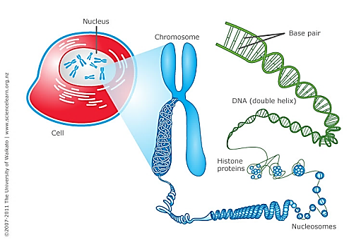
Cellular Reproduction
Chromosome
Chromosomes
Found in nucleus
Made up of DNA wrapped around proteins called histones
Notes:
Chromosomes
Found in the nucleus
Made of DNA tightly wrapped around proteins
Function: Package DNA before splitting during anaphase
Sections of DNA are genes
_____

Slide 4
Cellular Reproduction
Chromosome
Chromosomes
Function: Package DNA before splitting during anaphase of the cell cycle
Notes:
Chromosomes
Found in the nucleus
Made of DNA tightly wrapped around proteins
Function: Package DNA before splitting during anaphase
Sections of DNA are genes
_____

Slide 5
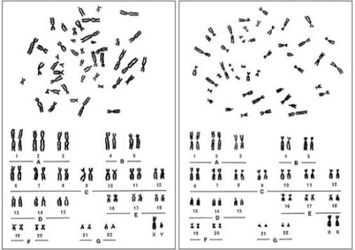
Cellular Reproduction
Chromosome
Chromosomes
Humans have 46 chromosomes in every cell in their body except the egg and sperm cells which have 23
Male
Female
Notes:
Chromosomes
Humans have 46 chromosomes
23 are received from each parent
Chromosomes are charted on karyotypes when studied
23rd chromosome determines sex
_____

Slide 6
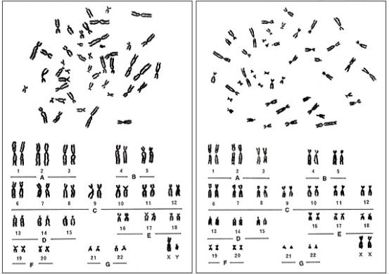
Cellular Reproduction
Chromosome
Chromosomes
Humans get 23 chromosomes from each parent
Charted on a karyotype when studied
Male
Female
Notes:
Chromosomes
Humans have 46 chromosomes
23 are received from each parent
Chromosomes are charted on karyotypes when studied
23rd chromosome determines sex
_____

Slide 7
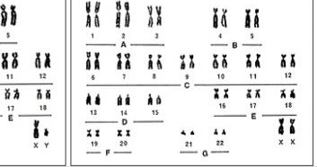
Male
Female

Slide 8
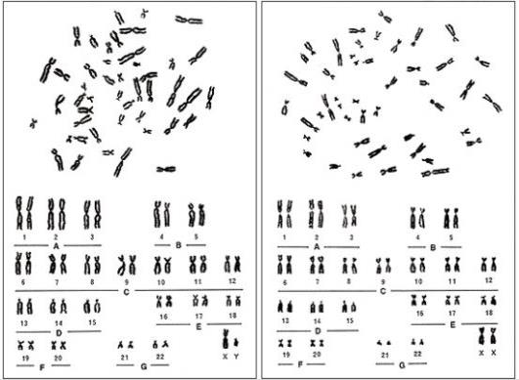
Cellular Reproduction
Chromosome
Homologous Pairs
Chromosomes are charted in homologous pairs. Homologous means same in structure. So humans have 23 pairs.
Male
Female
Notes:
Chromosomes
Humans have 46 chromosomes
23 are received from each parent
Chromosomes are charted on karyotypes when studied
23rd chromosome determines sex
_____

Slide 9
Cellular Reproduction
Chromosome
Fun Facts
Dogs have 39 pairs.
Fruit flies have 4 pairs.
Horses have 32 pairs.
Male
Female
Notes:
Chromosomes
Humans have 46 chromosomes
23 are received from each parent
Chromosomes are charted on karyotypes when studied
23rd chromosome determines sex
_____

Slide 10
Molecular Basis of Heredity
Chromosome
Illustrate a chromosome and label the parts
Notes:
Chromosome Structure
Chromosomes are made of DNA tightly wrapped around proteins called histines.
Chromatid = each half of the chromosome
Centromere = center
Telomere = each of the four tips
Q arm = long arm
P arm = short arm
_____

Slide 11
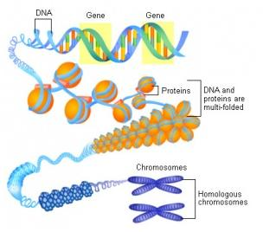
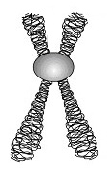
Molecular Basis of Heredity
Chromosome
Notes:
Chromosome Structure
Chromosomes are made of DNA tightly wrapped around proteins called histines.
Chromatid = each half of the chromosome
Centromere = center
Telomere = each of the four tips
Q arm = long arm
P arm = short arm
_____

Slide 12
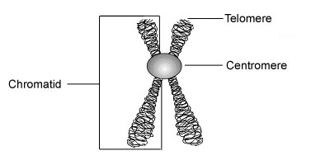
Molecular Basis of Heredity
Chromosome
Chromosome
When unwrapped, chromosomes are called “chromatin”.
Notes:
Chromosome Structure
Chromatid = each half of the chromosome
Centromere = center
Telomere = each of the four tips
Q arm = long arm
P arm = short arm
_____

Slide 13
What is a Chromosome?
Notes:
What is a Chromosome Video:
https://www.youtube.com/watch?v=xUrlreMaUrs

Slide 14
Let’s Explore Karyotypes
Digital Activity

Slide 15
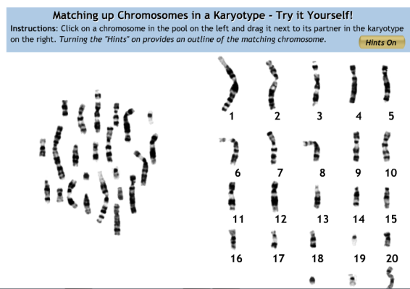
Make a Karyotype
Notes:
http://learn.genetics.utah.edu/content/basics/karyotype/

Slide 16
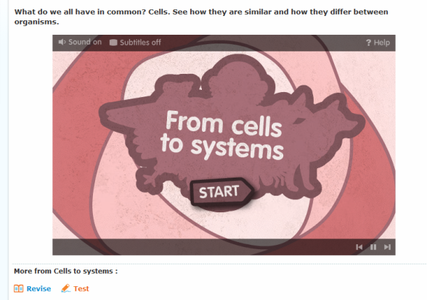
Cells to Systems

Slide 17
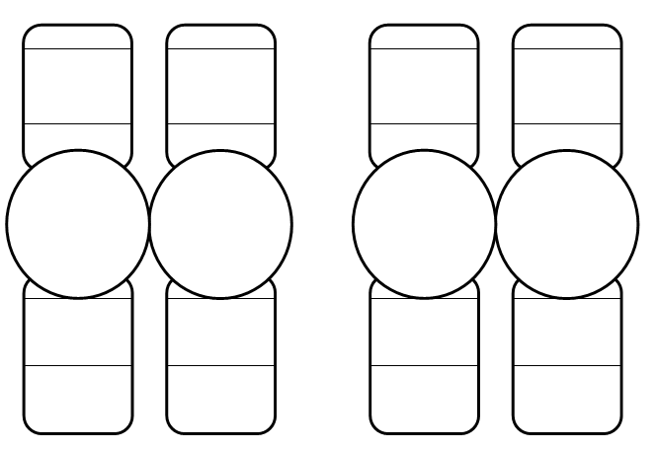

Slide 18
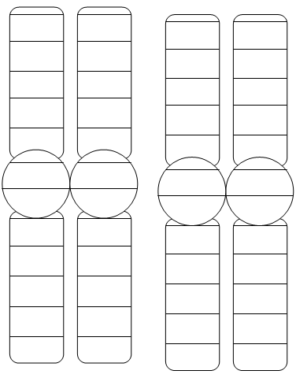

Slide 19
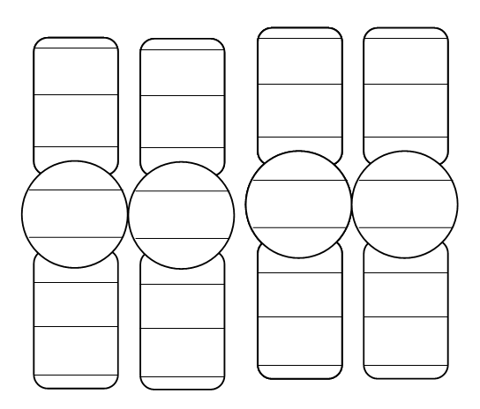

Slide 20
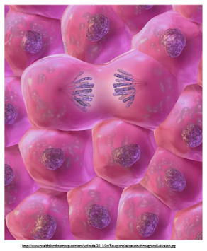
Cellular Reproduction
Multicellular Organisms
Multicellular Organisms
Humans begin as a single cell that reproduces until an organism is formed. Because we are made of many cells, we are multicellular.

Slide 21
Cellular Reproduction
Multicellular Organisms
Two Categories of Human Cells
Gametes
Somatic

Slide 22
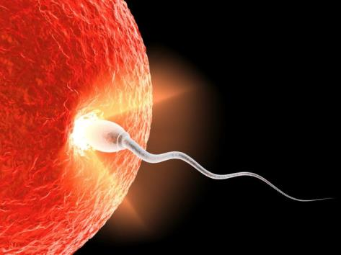
Cellular Reproduction
Multicellular Organisms
Gametes
Gametes are the sex cells, or the sperm and egg. Egg cells are also called ovum, or oocytes.

Slide 23
Cellular Reproduction
Multicellular Organisms
Gametes
Tip to Remember: the sperm and egg play a game and mate! “Game-Mates”

Slide 24
Cellular Reproduction
Multicellular Organisms
Gametes
23 chromosomes
Gamemates are Haploid cells - meaning “half” or having unpaired chromosomes.

Slide 25
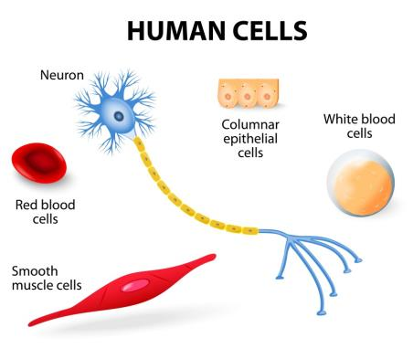
Cellular Reproduction
Multicellular Organisms
Somatic Cells
Every cell in the human body that is not a gamete is a somatic cell.

Slide 26
Cellular Reproduction
Multicellular Organisms
Somatic Cells
46 chromosomes, 23 from each parent so there are 23 pairs

Slide 27
Cellular Reproduction
Multicellular Organisms
Somatic Cells
Somatic cells are diploid cells.
Diploid means containing pairs of chromosomes

Slide 28
Fertilization
Notes:
Fertilization:
https://www.youtube.com/watch?v=_5OvgQW6FG4
_______

Slide 29
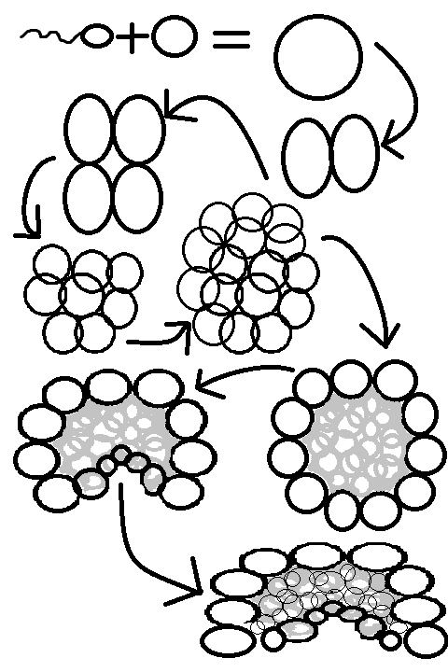

Slide 30
Cellular Reproduction
Multicellular Organisms
Fertilization
The process begins with fertilization
when the sperm penetrates the egg.
Notes:
Fertilization: The process begins with fertilization when the sperm penetrates the egg.
_____

Slide 31
Cellular Reproduction
Multicellular Organisms
Gametes
The egg and sperm cells are called gametes.
Each contain 23 chromosomes.
Notes:
Gametes: The egg and sperm cells are called gametes.
Each gamete contains 23 chromosomes
_____

Slide 32
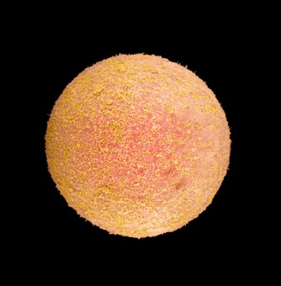
Cellular Reproduction
Multicellular Organisms
Zygote
Gametes join forming a zygote. This is the first cell of an organism. The zygote contains 46 chromosomes, 23 from each gamete.
Notes:
Zygote: Gametes join forming a zygote. This is the first cell of an organism.
The zygote contains 46 chromosomes, 23 from each gamete.
_____

Slide 33
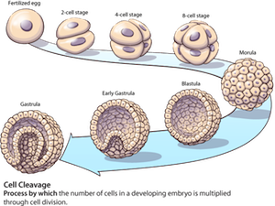
Gametes
Development of Multicellular Organisms
Division of the Zygote
Zygote
Morula
Blastula
Gastrula
Cell Differentiation
Notes:
Next the Zygote reproduces in a process called “cleavage”.
Each new cell is an exact copy of the other.
Each new cell contains a copy of the same 46 chromosomes.
Once it divides to 16 cells, it resembles a mulberry, which is why it is then called the “Morula”, Latin for mulberry.
Soon the morula hollows out and becomes a “Blastula” Greek for “sprout”
_____

Slide 34
Gametes
Development of Multicellular Organisms
Division of the Zygote
Zygote
Morula
Blastula
Gastrula
Cell Differentiation
Notes:
The blastula contains embryonic stem cells. We are going to spend some time talking about stem cells today.
_____

Slide 35
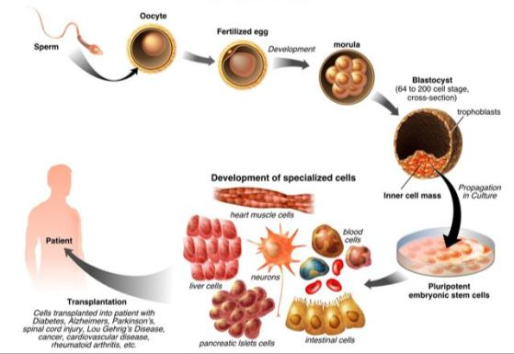
Cellular Reproduction
Embryotic Stem Cells
Stem Cells
Undifferentiated, pluripotent cells that become a specialized cell.
Notes:
Stem Cells: Undifferentiated cells that can give rise to a specialized cell.
_____

Slide 36
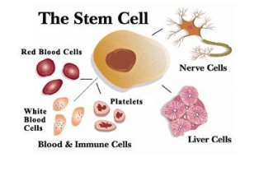
Cellular Reproduction
Multicellular Organisms
Differentiation
Stem cells become different types of cells, they become specialized.
Notes:
Differentiation: Stem cells become different types of cells, they become specialized
_____

Slide 37
What Can Stem Cells Do?
Notes:
Video: What Can Stem Cells Do?:
https://www.youtube.com/watch?v=K7D6iA7bZG0

Slide 38
A Stem Cell Story 15:00
Notes:
Additional video if Interested – this is great, its 15 minutes but worth it:
A Stem Cell Story
https://www.youtube.com/watch?v=2-3J6JGN-_Y

Slide 39
Let’s Explore Stem Cells
Activity
Notes:
Stem Cells
Hand out pipe cleaners. Each represents a stem cell. Students are to bend their pipe cleaner into any cell shape desired to represent the process of differentiation.
_______

Slide 40
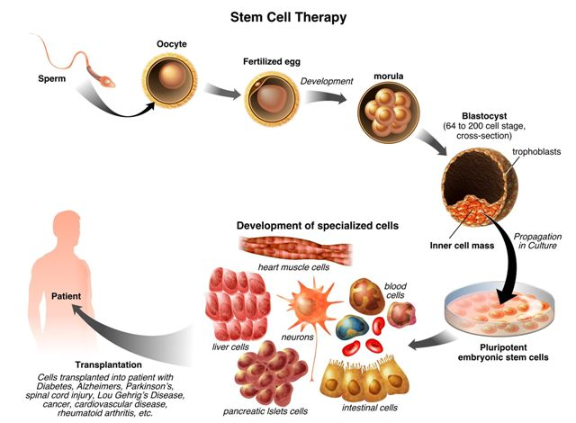
Cellular Reproduction

Slide 41
Gametes
Zygote Cleavage
Division of the Zygote
Zygote
Morula
Blastula
Gastrula
Cell Differentiation
Notes:
Cells go through the processes of differentiation when transitioning from the blastula to the gastrula.
_____

Slide 42
Cellular Reproduction
Multicellular Organisms
Germ Layers
The Gastrula divides into
three layers of cells called
germ layers
Notes:
Gastrula is arranged in three parts of differentiated cells, called “Germ Layers”:
Endoderm
Mesoderm
Ectoderm
_____

Slide 43
Cellular Reproduction
Multicellular Organisms
Germ Layers
Ectoderm
Mesoderm
Endoderm
Notes:
Gastrula is arranged in three parts of differentiated cells, called “Germ Layers”:
Endoderm
Mesoderm
Ectoderm
_____

Slide 44
Germ Layers
Notes:
Video Formation of Blastocyst and Germ Layers Video
Important Note: Show Clips #7,8,9 (that is 6 minutes of video)
http://media.hhmi.org/hl/06Lect1.html
_____

Slide 45
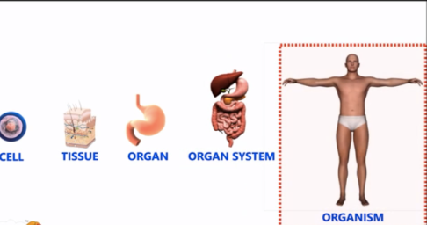
Cellular Reproduction
Multicellular Organisms
Cellular Organization
Organelle
Cell
Tissue
Organ
Organ system
Organism
Notes:
Cells are organized from simple to complex:
Cell
Tissue
Organ
Organ system
organism
_____

Slide 46
Let’s Explore Cellular Organization
Digital Activity
Notes:
_______

Slide 47
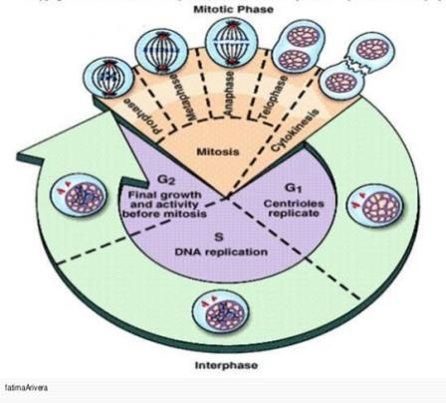
Cellular Reproduction
The Cell Cycle
Cell Cycle
Somatic cells reproduce in a continuous cell cycle.

Slide 48
Cellular Reproduction
The Cell Cycle
Cell Cycle
Two main phases:
Mitosis
Interphase

Slide 49
Cellular Reproduction
Cell Cycle
Mitosis
Division of parent cell into two identical daughter cells. Occurs in nucleus.
Remember: “Mi-TWO-sis” makes two identical daughter cells like twin sisters!
Notes:
Mitosis
Division of parent cell into two identical daughter cells.
Occurs in nucleus
_____

Slide 50
Cellular Reproduction
Cell Cycle
Mitosis
Stages of mitosis:
Prophase
Metaphase
Anaphase
Telophase
Instructions: Shade the mitosis phase of the cell cycle in your work packet.
PMAT
Notes:
Mitosis
Division of parent cell into two identical daughter cells.
Occurs in nucleus
_____

Slide 51
Cellular Reproduction
Cell Cycle
Interphase
Most of the cell’s lifetime is spent in Interphase. During this phase cells replicate their DNA, grow, develop and carry out their normal functions.
Instructions: Shade the interphase phase of the cell cycle in your work packet.
Notes:
Mitosis
Division of parent cell into two identical daughter cells.
Occurs in nucleus
_____

Slide 52
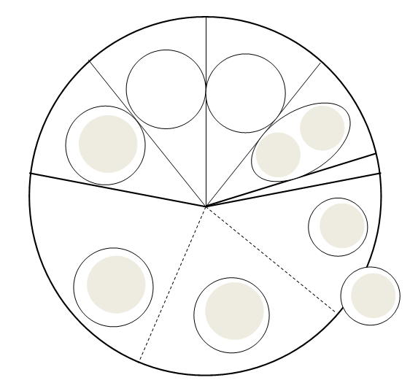
Label
Mitosis
Interphase
Illustrate
Phases of cell cycle

Slide 53
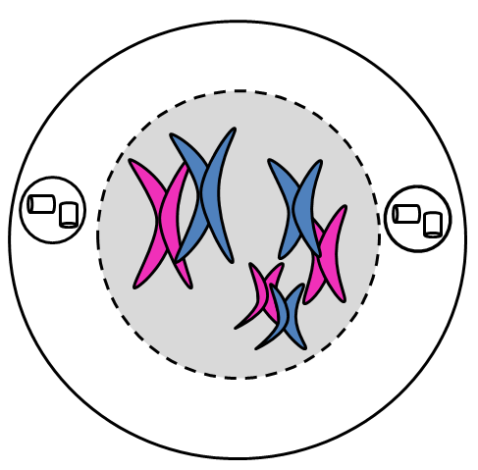
Cellular Reproduction
Mitosis
Prophase
Chromatin condenses into chromosomes.
Centrioles move to opposite ends.
Notes:
Mitosis
Prophase: Chromatin condenses into chromosomes.
_____

Slide 54
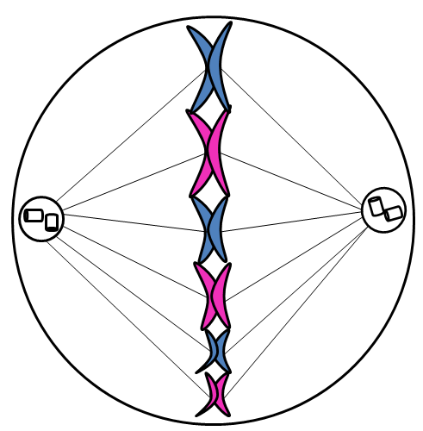
Cellular Reproduction
Mitosis
Metaphase
Chromosomes line up in the middle. Spindle fibers form from centrioles to chromosomes.
Notes:
Mitosis
Metaphase: Chromosomes line up in the middle. Spindle fibers form from the centrioles to chromosomes.
_____

Slide 55
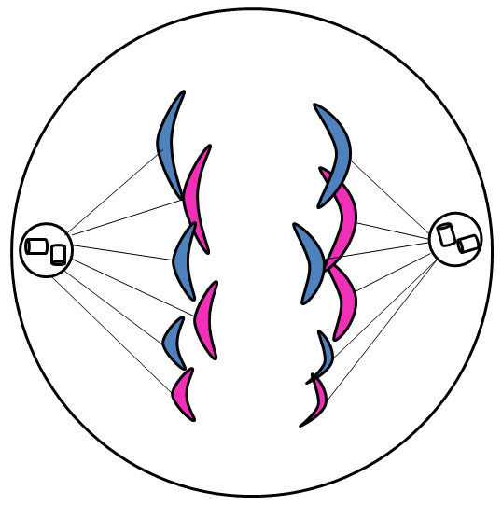
Cellular Reproduction
Mitosis
Anaphase
Spindle fibers pull chromosomes apart toward the centrioles.
Notes:
Mitosis
Anaphase: Spindle fibers pull chromosomes apart toward the centrioles.
_____

Slide 56
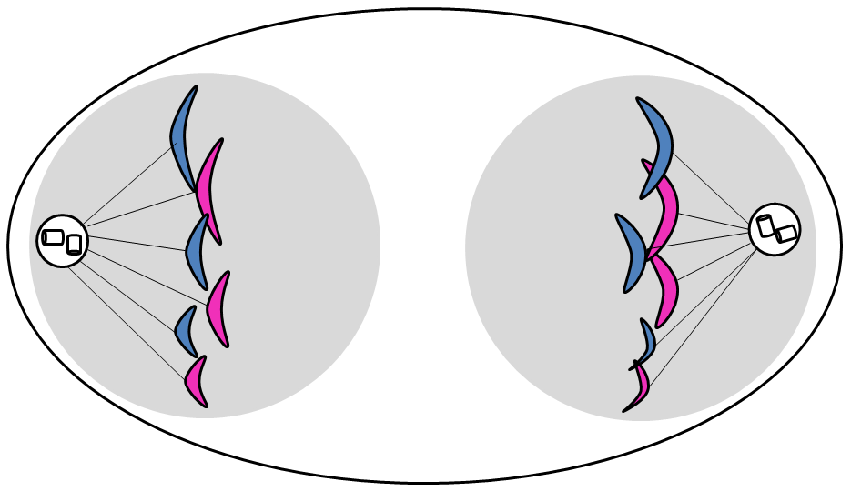
Cellular Reproduction
Mitosis
Telophase
Nuclear envelope forms around each group of chromosomes.
Notes:
Mitosis
Telophase: Nuclear envelope forms around each group of chromosomes.
_____

Slide 57
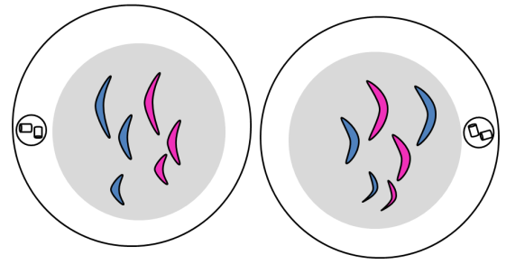
Cellular Reproduction
Cytokinesis
The cytoplasm splits resulting in two identical cells called “daughter cells”.
Notes:
Mitosis
Cytokinesis: The cytoplasm spits resulting in two identical cells called “daughter cells”.
_____

Slide 58
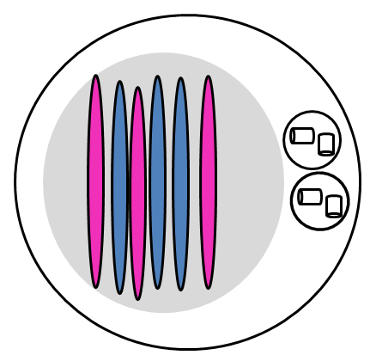
Cellular Reproduction
Cell Cycle
Interphase
Chromosomes unwind and replicate the half of the chromosome that was split apart during anaphase.
Notes:
Mitosis
Interphase: Chromosomes unwind and replicate the half of the chromosome that was split apart during anaphase.
_____

Slide 59
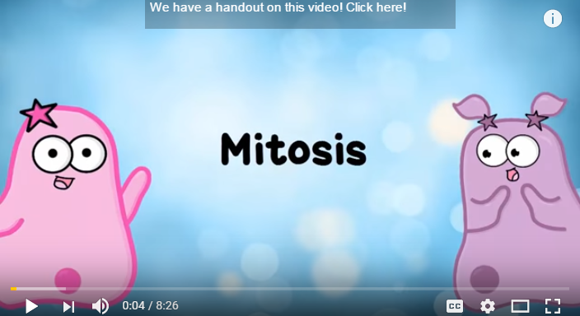
Mitosis
Notes:
https://www.youtube.com/watch?v=f-ldPgEfAHI

Slide 60
Mitosis Rap
Notes:
Review
Mitosis Rap Video:
Instructions: Watch for review ☺
https://www.youtube.com/watch?v=YLuTj8LplVM
_____

Slide 61
Let’s Explore Mitosis Onion Root Lab
Digital Activity
Notes:
http://www.biology.arizona.edu/cell_bio/activities/cell_cycle/cell_cycle.html

Slide 62
Cellular Reproduction

Slide 63
Cellular Reproduction
Meiosis
Meiosis
Oocytes go through meiotic division
and become egg cells.
Spermazoids go through meiotic division
and become sperm cells.
Notes:
Meiosis
Cell division of gametes (sperm & egg).
Includes the crossing over of genetic information between chromosomes.
Reduces number of chromosomes from 46 to 23.
Occurs in 2 Phases: Meiosis 1 and 2, each phase has 5 steps.
_____

Slide 64
Cellular Reproduction
Meiosis
Meiosis
Cell division resulting in gametes (sperm and egg)
Meiosis reduces the number of chromosomes to 23
Meiosis results in four genetically different cells called haploid granddaughter cells.
Notes:
Meiosis
Cell division of gametes (sperm & egg).
Includes the crossing over of genetic information between chromosomes.
Reduces number of chromosomes from 46 to 23.
Occurs in 2 Phases: Meiosis 1 and 2, each phase has 5 steps.
_____

Slide 65
Cellular Reproduction
Meiosis
Meiosis
Haploid means having “half” the chromosomes, or having a “single set” of chromosomes.
Remember: “ME-oisis” made the cells that made me!
Notes:
Meiosis
Cell division of gametes (sperm & egg).
Includes the crossing over of genetic information between chromosomes.
Reduces number of chromosomes from 46 to 23.
Occurs in 2 Phases: Meiosis 1 and 2, each phase has 5 steps.
_____

Slide 66
Cellular Reproduction
Meiosis
Genetic Variation
Meiosis results in genetic variation within a species for three important reasons:
Crossing over of genetic material during Prophase 1 of Meiosis
Independent assortment of genetic material during Metaphase 1 of Meiosis
Notes:
Meiosis
Cell division of gametes (sperm & egg).
Includes the crossing over of genetic information between chromosomes.
Reduces number of chromosomes from 46 to 23.
Occurs in 2 Phases: Meiosis 1 and 2, each phase has 5 steps.
_____

Slide 67
Cellular Reproduction
Meiosis
Genetic Variation
3. Random fertilization
Females are born with about 200 million eggs. Most die before puberty when we are left with about 300,000.
Males will make about 525 billion sperm cells over a lifetime.
Notes:
Meiosis
Cell division of gametes (sperm & egg).
Includes the crossing over of genetic information between chromosomes.
Reduces number of chromosomes from 46 to 23.
Occurs in 2 Phases: Meiosis 1 and 2, each phase has 5 steps.
_____

Slide 68
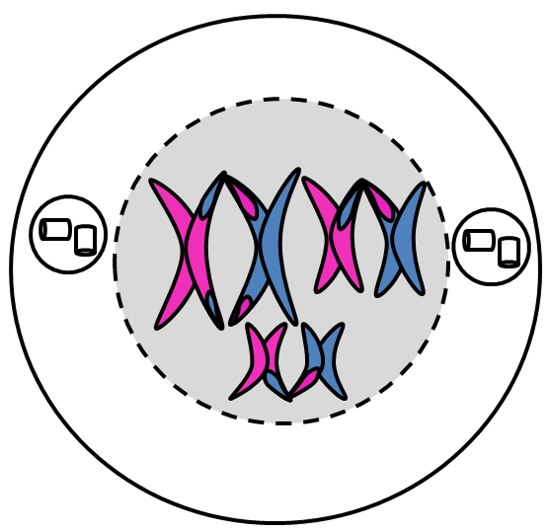
Cellular Reproduction
Meiosis I
Prophase I
46 Homologous Chromosomes pair up.
Homologous pairs exchange DNA, this is called “Crossing Over”
Notes:
Meiosis I
Prophase I
46 Homologous Chromosomes line up.
Crossing over between chromosomes occurs.
Note: homologous means the same, we have 23 specific chromosomes, the same chromosome from the sperm and the egg line up side by side
_____

Slide 69
Cellular Reproduction
Meiosis I
Prophase I
“Crossing Over” results in genetic variation.
Nuclear Envelope dissipates.
Notes:
Meiosis I
Prophase I
46 Homologous Chromosomes line up.
Crossing over between chromosomes occurs.
Note: homologous means the same, we have 23 specific chromosomes, the same chromosome from the sperm and the egg line up side by side
_____

Slide 70
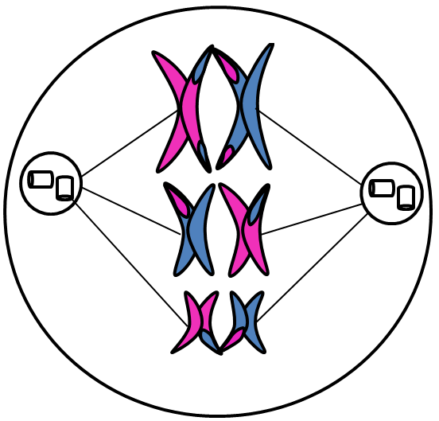
Cellular Reproduction
Meiosis I
Metaphase I
Homologous pairs line up along the equator of the nucleus. It doesn’t matter which side of the equator the chromosome from each parent are on. This is called “Independent Assortment”
Notes:
Meiosis I
Metaphase I
Independent assortment occurs when homologous chromosomes line up side by side in the middle
Spindle fibers attach the centromeres to the chromosomes.
____

Slide 71
Cellular Reproduction
Meiosis I
Metaphase I
“Independent Assortment” results in genetic variation.
Spindle fibers attach the centrioles to the centromeres of the chromosomes.
Notes:
Meiosis I
Metaphase I
Independent assortment occurs when homologous chromosomes line up side by side in the middle
Spindle fibers attach the centromeres to the chromosomes.
____

Slide 72
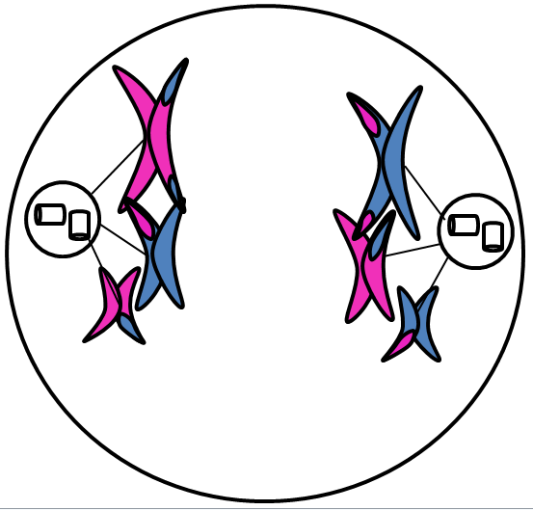
Cellular Reproduction
Meiosis I
Anaphase I
Spindle fibers pull the homologous chromosomes apart.
Notes:
Meiosis I
Anaphase I
Spindle fibers pull the homologous chromosomes apart.
____

Slide 73
Cellular Reproduction
Meiosis I
Anaphase I
Pulling the entire chromosome will reduce the number of chromosomes to half, 23 instead of 46, at the end of Meiosis 1.
Notes:
Meiosis I
Anaphase I
Spindle fibers pull the homologous chromosomes apart.
____

Slide 74
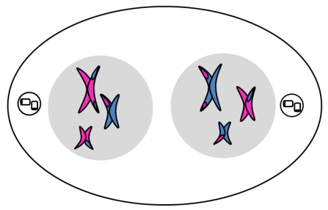
Cellular Reproduction
Meiosis I
Telophase I
Nuclear envelopes form around chromosomes at polar ends of the cell.
Notes:
Meiosis I
Telophase I
2 cells are created.
Each cell has 23 chromosomes which is half the number of the original cell (remember, these are sex cells, so the end result will be 23, the purpose of meiosis is dividing a cell that has 46 chromosomes into cells with 23 chromosomes).
____

Slide 75
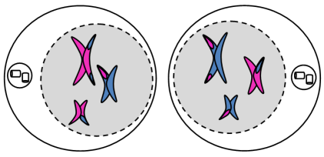
Cellular Reproduction
Meiosis II
Prophase II
Each cell begins with 23 chromosomes.
Centrioles move to polar ends of cells.
Nuclear envelopes dissipate
Notes:
Meiosis II
Prophase II
Each cell begins with 23 chromosomes.
Centrioles move to polar ends of cells.
Note: This diagram should be the first thing you sketch on the bottom half of your Meiosis Chart. The diagram on this slide and the sketch you are making on the Meiosis Chart are both representing two cells. Your chart looks a little different because it has two full circles side by side for cells and the slide has two cells that are squished together on top of each other. Both represent the same thing.
____

Slide 76
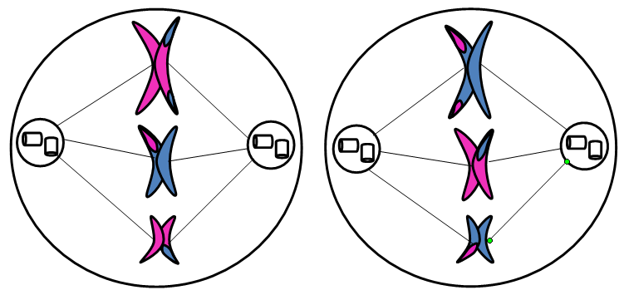
Cellular Reproduction
Meiosis II
Metaphase II
Chromosomes line up in the middle of each cell.
Spindle fibers attach centrioles to chromosomes
Notes:
Meiosis II
Metaphase II
Chromosomes line up in the middle of each cell.
____

Slide 77
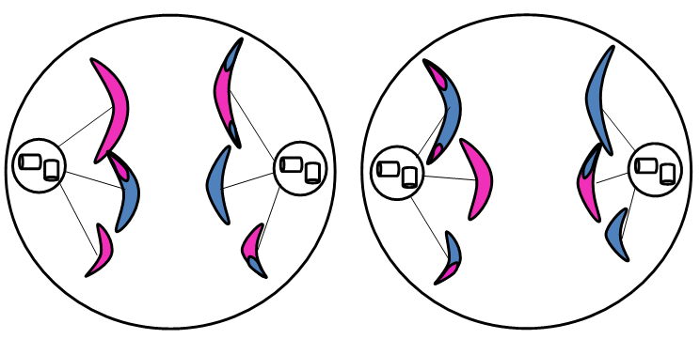
Cellular Reproduction
Meiosis II
Anaphase II
Spindle fibers pull chromosomes apart (rip in half, just like mitosis).
Notes:
Meiosis II
Anaphase II
Spindle fibers pull chromosomes apart (rip in half, just like mitosis).
____

Slide 78
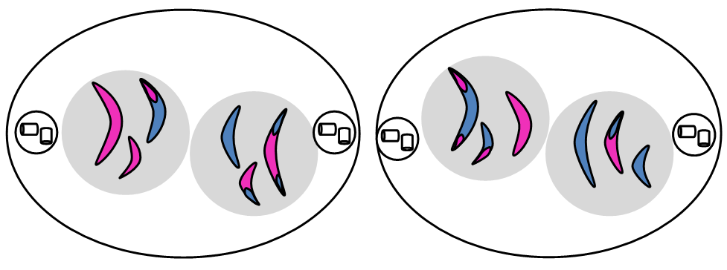
Cellular Reproduction
Meiosis II
Telophase II
Nuclear envelopes form around set of chromatids.
Notes:
Meiosis II
Telophase II
Nuclear Envelopes form around each cell
____

Slide 79
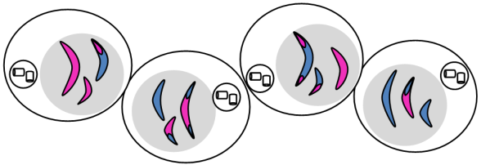
Cellular Reproduction
Meiosis II
Cytokinesis
Cytokinesis occurs resulting in 4 genetically different cells.
Notes:
Meiosis II
Cytokinesis
Cytokinesis occurs resulting in 4 genetically different cells.
____

Slide 80
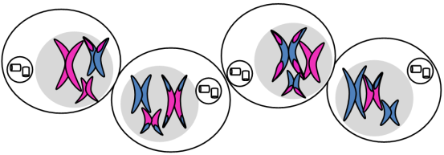
Cellular Reproduction
Meiosis
Interphase
DNA replicates resulting in four genetically different haploid granddaughter cells.
Notes:
Meiosis
Interphase
DNA replicates
Instructions: when sketching this entire chart, please use two colors to illustrate chromosomes from both gametes. You may use markers, a pencil and pen, two pens, colored pencils, or anything else, but you must use two colors. Interphase goes on the first circle at the top of your chart.
_____

Slide 81
How Meiosis Works
Notes:
Meiosis:
Video Re-cap: How Meiosis Works
Video: https://www.youtube.com/watch?v=CMXjBgLjjxo
https://www.youtube.com/watch?v=toWK0fIyFlY&t=337s
_____

Slide 82
References
References are in the slide notes for this presentation
Notes:
References are in the slide notes for this presentation.

