Slide 1
Interdependence
Indiana Standard: 4
Notes:
Interdependence
_____

Slide 2
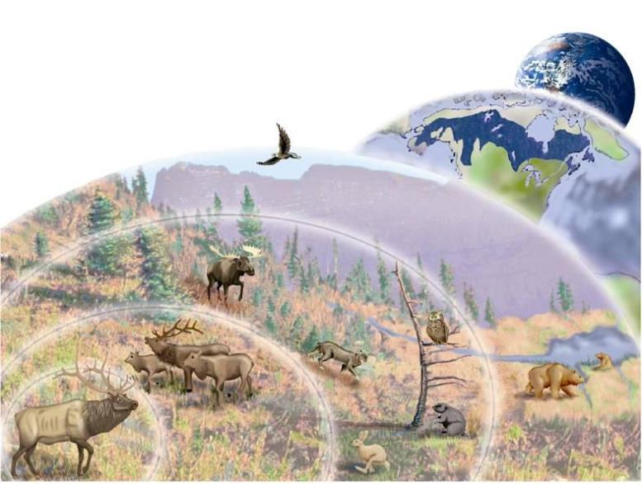
Interdependence
Ecology
Ecology
Study of interactions among living things and their surroundings.
Notes:
Interdependence
Ecology: Study of interactions among living things and their surroundings.
_____

Slide 3
Interdependence
Ecology
Biosphere
All living, nonliving things and the climate.
Notes:
Interdependence
Biosphere: All living, nonliving things and the climate.
____

Slide 4
Interdependence
Ecology
Biome
Global community defined by the climate and plant communities.
Notes:
Interdependence
Biome: Global community defined by the climate and plant communities.
_____

Slide 5
Interdependence
Ecology
Ecosystem
All living &
non-living things in an area
Biotic - Living things
Abiotic - Non-living things
Notes:
Interdependence
Ecosystem: All living and non-living things in a given area.
Biotic: Living things
Abiotic: Non-living things (examples: climate, soil, sunlight water, weather, etc)
_____

Slide 6
Interdependence
Ecology
Community
Group of different species living together in an area.
Notes:
Interdependence
Community: Group of different species living together in an area.
______

Slide 7
Interdependence
Ecology
Population
Group of the same species living in one area.
Notes:
Interdependence
Population: Group of the same species living in one area.
_____

Slide 8
Interdependence
Ecology
Organism
One individual living thing.
Notes:
Interdependence
Organism: One individual living thing.
_____

Slide 9
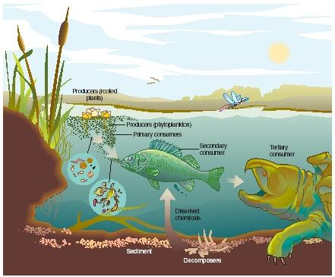
Interdependence
within an Ecosystem
Ecosystem
All living and non-living things in a given area and
All depend
on one another.
Notes:
Interdependence
We are going to focus on ecosystems for the rest of this unit. Remember, the name of this unit is “Interdependence”. This is because we will be taking a close look at how all of the living and non-living things, including the climate, affect each other within ecosystems.
_______

Slide 10
Interdependence
within an Ecosystem
Habitat
All biotic and abiotic factors in an organisms home
Niche
All the things the organism does in its habitat
Notes:
Interdependence
Within ecosystems, organisms occupy a habitat and have a niche.
Habitat: All the biotic and abiotic factors in the organisms home.
Niche: All the things the organism does in it’s habitat
_______

Slide 11
Ecosystems
All Living & Non-living Things in an Area
Biodiversity
Variety of living
things
Keystone Species
Species that has a
large effect on ecosystem
Notes:
Ecosystems
Biodiversity: Variety of living things
Keystone Species: Species that has a large effect on an ecosystem
Which of the organisms in the pictured ecosystem would be considered keystone? In other words, which might cause a collapse of the ecosystem if it were eliminated? Answer: if the producers were removed, there would be nothing for the consumers to feed on, so the rooted plants or phytoplankton would be keystone species in this environment if there were no other producers for the primary consumers to feed on.
_______

Slide 12
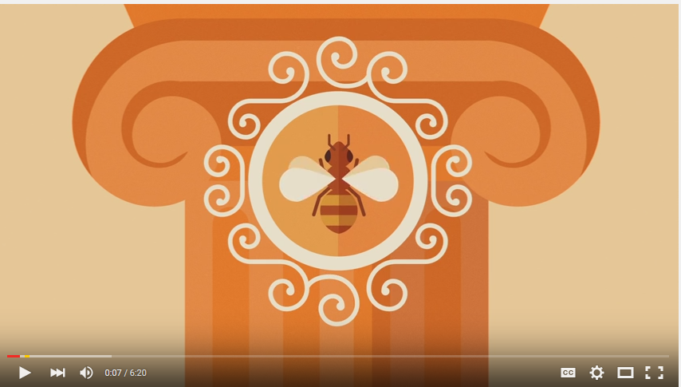
Endangered Keystone Species
Honeybees
Notes:
Ecosystems and Changes in Community
Since the organisms in ecosystems are interdependent upon each other, the entire ecosystem could be at risk if one species is removed, especially if it is a keystone species.
One keystone species currently at risk is the honey bee.
Video:
https://www.youtube.com/watch?v=GqA42M4RtxE
________

Slide 13
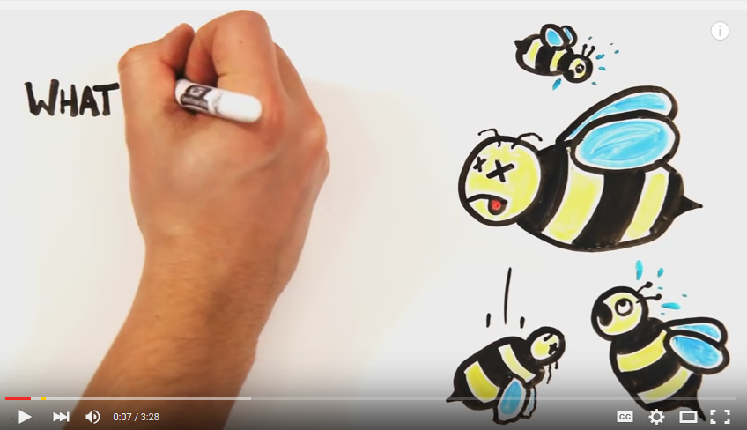
Endangered Keystone Species
Honeybees
Notes:
Ecosystems and Changes in Community
Video:
https://www.youtube.com/watch?v=JilYBVrFiLA
Take the Honeybee pledge and Map :
http://www.honeybeehaven.org/content/take-pledge

Slide 14
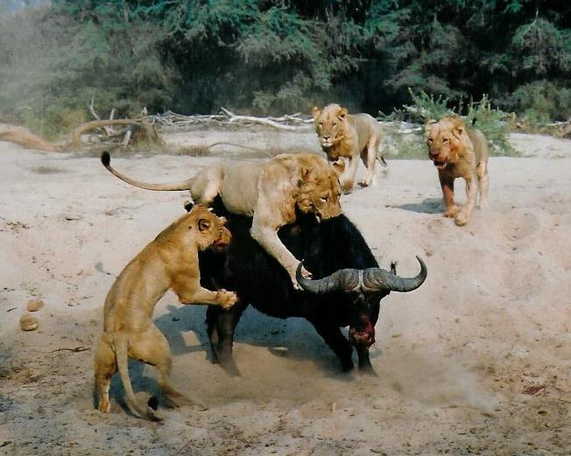
Interdependence
Ecological Relationships
Competition
When two or more organisms compete for the same environmental resource.
Notes:
Interdependence
_____

Slide 15
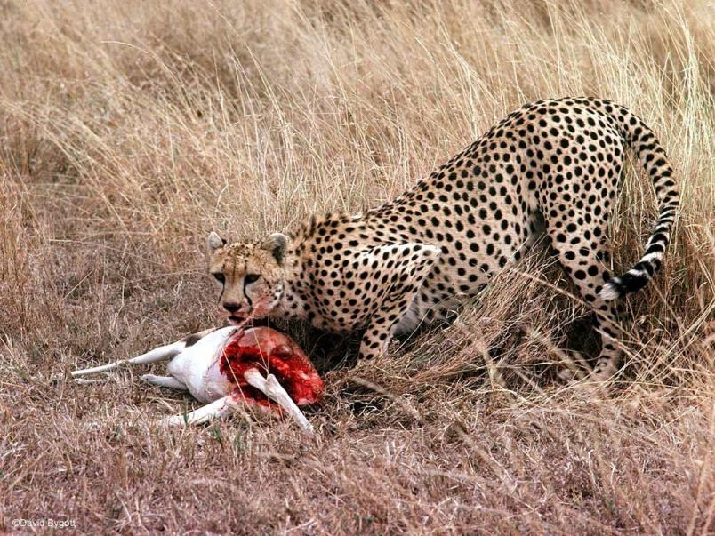
Interdependence
Ecological Relationships
Predation
Behavior of one animal hunting and feeding on another.
Notes:
Interdependence
_____

Slide 16
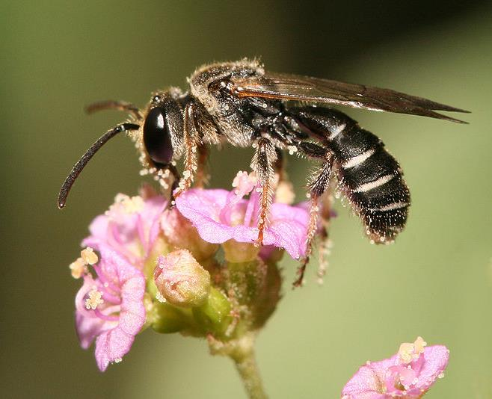
Interdependence
Ecological Relationships
Mutualism
Relationship where both organisms benefit.
Notes:
Interdependence
_____

Slide 17
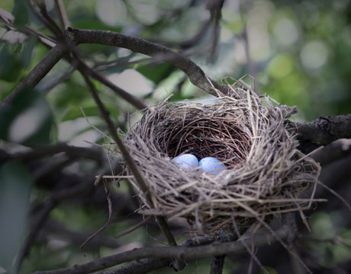
Interdependence
Ecological Relationships
Commensalism
Relationship where one organism benefits and one does not, but is unharmed.
Notes:
Interdependence
_____

Slide 18
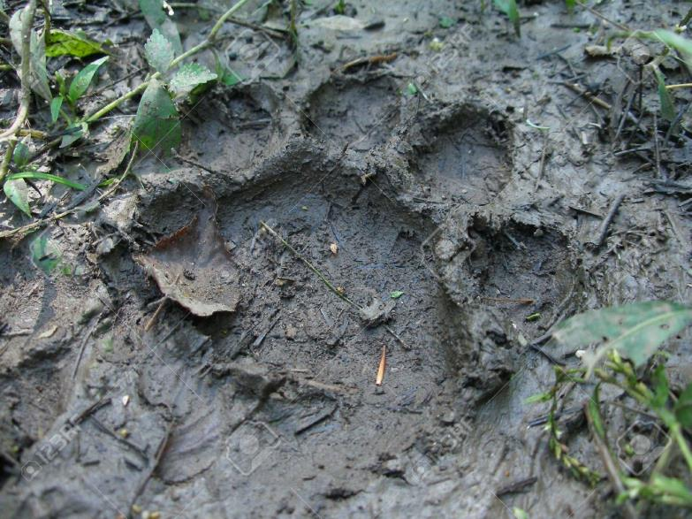
Interdependence
Ecological Relationships
Amensalism
Relationship where one organism is harmed and the other is not affected.
Notes:
Interdependence
_____

Slide 19
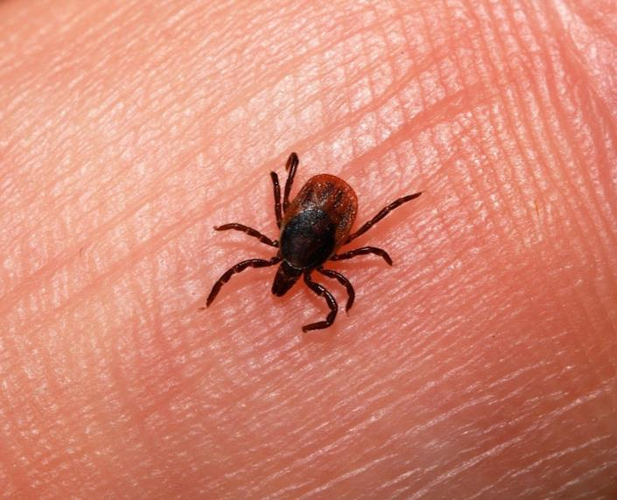
Interdependence
Ecological Relationships
Parasitism
Relationship where one organism benefits by feeding on a host.
Notes:
Interdependence
_____

Slide 20
Let’s Explore Ecosystems
LAB
Notes:
Outside Activity:
Designate an ecosystem of your choice and sketch it’s components. Specify the biotic and abiotic factors. Specify the “biome it is in, the community, populations and one species”
2. Plant sunflower seeds and hyssop to create a safe haven for honeybees.
Hyssop Planting Information
If you want to attract hummingbirds, bees and butterflies to your flower garden, grow Agastache foeniculum. It is commonly referred to as Anise Hyssop, and it is a lovely perennial that has a wonderful anise or licorice-like scent. It is perfect for the cottage garden, herb garden or perennial border. Grow Anise Hyssop in containers on the patio or porch as well. It prefers full sun to partial shade and well-drained soil. It is usually deer resistant, and once it is established, it does very well in dry climates needing minimal amounts of water. The flower spikes have lavender to purple colored blooms and bloom from mid-summer until fall. The blooms dry nicely and make great additions to floral arrangements. Anise Hyssop reseeds easily and spreads quickly to fill in sparse areas in the garden. Start the seed directly outdoors in either the late fall or early spring. Do not cover the seed but press it tightly into the soil. Space the plants 18 - 24 inches apart.
Order Hyssop Here:
http://www.amazon.com/Outsidepride-Anise-Hyssop-5000-Seeds/dp/B004U249UQ/ref=sr_1_2?ie=UTF8&qid=1445101163&sr=8-2&keywords=hyssop+seeds
________

Slide 21
Matter Cycles
Matter is never destroyed.
It is converted from one state to another.
Nitrogen Cycle
Carbon Cycle
Water Cycle

Slide 22
The Nitrogen Cycle
Notes:
The Nitrogen Cycle
Video: https://www.youtube.com/watch?v=oy8e2HrOh6Q
Ask the following questions following the video:
What two things break the bonds of nitrogen so it can be used in the nitrogen cycle?
What is the name of the process that that converts nitrogen into usable forms?
How does nitrogen enter the food chain?
How is nitrogen returned to the soil?
_____

Slide 23
What two things break the bonds of nitrogen so it can be used in the nitrogen cycle?
What is the name of the process that that converts nitrogen into usable forms?
How does nitrogen enter the food chain?
How is nitrogen returned to the soil?

Slide 24
What two things break the bonds of nitrogen so it can be used in the nitrogen cycle?

Slide 25
What two things break the bonds of nitrogen so it can be used in the nitrogen cycle? Lightning and bacteria.

Slide 26
What is the name of the process that that converts nitrogen into usable forms?

Slide 27
What is the name of the process that that converts nitrogen into usable forms? Nitrogen fixation.

Slide 28
How does nitrogen enter the food chain?

Slide 29
How does nitrogen enter the food chain? Plants absorb it through the roots.
Animals eat the plants.

Slide 30
How is nitrogen returned to the soil?

Slide 31
How is nitrogen returned to the soil? Decomposition of plants and animals, and animal waste.

Slide 32
The Nitrogen Cycle
Notes:
The Nitrogen Cycle
Students will complete PODGIL activity.
_____

Slide 33
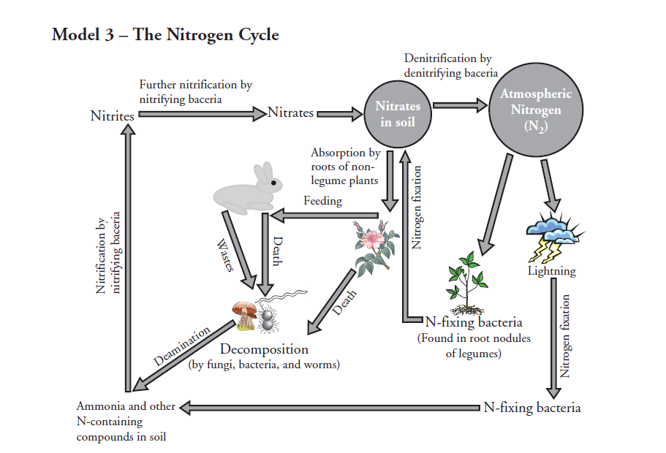
Model 3 Illustrates how nature recycles what natural resource?

Slide 34
Model 3 Illustrates how nature recycles what natural resource? Nitrogen

Slide 35
Name three types of bacteria involved in the nitrogen cycle.

Slide 36
Name three types of bacteria involved in the nitrogen cycle? Denitrifying, nitrogen-fixing, nitrifying.

Slide 37
In what ways is Nitrogen gas removed from the atmosphere?

Slide 38
In what ways is Nitrogen gas removed from the atmosphere? Nitrogen fixation by lightning and nitrogen fixing bacteria.

Slide 39
By what process are animal wastes and dead organisms converted to other nitrogen containing compounds?

Slide 40
By what process are animal wastes and dead organisms converted to other nitrogen containing compounds? Decomposition or Deamination.

Slide 41
What is the only form of nitrogen that non-legume plants can take in and use?

Slide 42
What is the only form of nitrogen that non-legume plants can take in and use? Nitrates.

Slide 43
What do denitrifying bacteria do during the denitrifying process?

Slide 44
What do denitrifying bacteria do during the denitrifying process? Convert nitrates back into atmospheric nitrogen.

Slide 45
If the number of nitrifying bacteria decreased, what effect would this have on the nitrogen cycle and what would accumulate as a result? Nitrites would not be converted to nitrates that plants need. Ammonia would accumulate.

Slide 46
If the number of nitrifying bacteria decreased, what effect would this have on the nitrogen cycle and what would accumulate as a result?

Slide 47
Let’s Explore The Nitrogen Cycle
LAB
Notes:
__________

Slide 48
Water Cycle Lab
4oo ml water
15 ml food coloring
2 celery stalks
1 leaf nappa cabbage
Pour food coloring in water.
Add 2 celery stalks and 1 leaf of nappa cabbage.
As a lab group, write a hypothesis about what changes might happen in the celery in the next 48 hours.

Slide 49
Block 1 Hypothesis
Lab 1 – The color will change on the whole piece of celery and cabbage.
Lab 2 – If we add food coloring to the water, the color of the plants will change.
Lab 3 – The vegetables will absorb the food coloring.
Lab 4 – If you put vegetables in food coloring they will turn blue.
Lab 5 – The vegetables in the food coloring will turn blue.
Lab 6 – If you put the celery and cabbage in the blue dye they will turn blue.
Lab 7 – The veins in the cabbage and celery will turn blue.

Slide 50
The Carbon Cycle
Notes:
The Carbon Cycle or Circle of Life
Melissa Landeen
https://www.youtube.com/watch?v=4vJ_1ojjlxw

Slide 51
The Carbon Cycle
Notes:
The Carbon Cycle
Students will complete PODGIL activity.
_____

Slide 52
The Carbon Cycle
Notes:
Carbon Cycle
Dfaulkes
https://www.youtube.com/watch?v=4poA1X7Gec4

Slide 53
The Water Cycle
Notes:
The Water Cycle
Students will complete PODGIL activity.
_____

Slide 54
The Water Cycle Rap
Notes:
https://www.youtube.com/watch?v=815RUEMdLqM
The Water Cycle Rap (with lyrics)
Infernite Raps

Slide 55
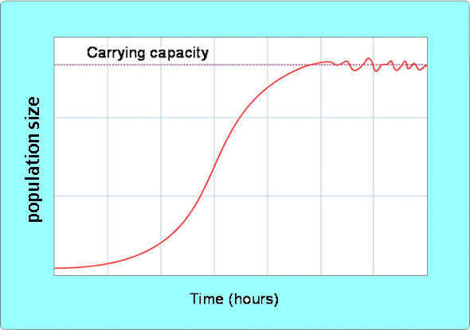
Population Size
Size of Populations Impact Ecosystems
Carrying Capacity
Maximum number of individuals an environment can support
Oscillation
Exponential Growth
(the rapid increase)
Logistic Growth (entire S curve)
Notes:
Ecosystems and Population Size
Ecosystems can only support populations up to the amount of the ecosystem’s carrying capacity. The carrying capacity is the maximum number of individuals an environment can support.
_____

Slide 56
Population Size
Size of Populations Impact Ecosystems
Limiting Factor
Something that limits the size of a population, such as food or shelter.
Oscillation
Exponential Growth
(the rapid increase)
Logistic Growth (entire S curve)
Notes:
Ecosystems and Population Size
When there are plenty of resources available, populations experience exponential growth because there are no limiting factors. Limiting factors limit the size of a population. Examples are food and shelter.
_____

Slide 57
Population Size
Size of Populations Impact Ecosystems
Abiotic Factors
Natural disasters
Temperature
Fire
Flood
Wind
Oscillation
Exponential Growth
(the rapid increase)
Logistic Growth (entire S curve)
Notes:
Ecosystems and Population Size
Population size can be greatly affected by abiotic (non-living) factors such as natural disasters, temperature, fire, flood, wind, etc. causing death individuals in a population, or by reducing the availability of food and shelter.
_____

Slide 58
Population Size
Size of Populations Impact Ecosystems
Biotic Factors
All living things
Oscillation
Exponential Growth
(the rapid increase)
Logistic Growth (entire S curve)
Notes:
Ecosystems and Population Size
Population size can be greatly affected by abiotic (non-living) factors such as natural disasters, temperature, fire, flood, wind, etc. causing death individuals in a population, or by reducing the availability of food and shelter.
_____

Slide 59
Population Size
Size of Populations Impact Ecosystems
Emigration
When individuals exit the environment (opposite of immigration).
Oscillation
Exponential Growth
(the rapid increase)
Logistic Growth (entire S curve)
Notes:
Ecosystems and Population Size
When resources are limited populations may try to find a new habitat, this is called emigration.
_____

Slide 60
Population Size
Size of Populations Impact Ecosystems
Immigration
When individuals come in to the environment
Oscillation
Exponential Growth
(the rapid increase)
Logistic Growth (entire S curve)
Notes:
Ecosystems and Population Size
When resources are plentiful, populations may experience immigration.
_____

Slide 61
Population Size
Size of Populations Impact Ecosystems
Oscillation
Exponential Growth
Logistic Growth
Oscillation
Exponential Growth
(the rapid increase)
Logistic Growth (entire S curve)
Notes:
Ecosystems and Population Size
Once resources begin to limit growth, population growth slows or stops to emigration or death related to competition, disease, or starvation.
From then on the population will oscillate around the carrying capacity.
This is called logistic growth, or the overall growth.
_____

Slide 62
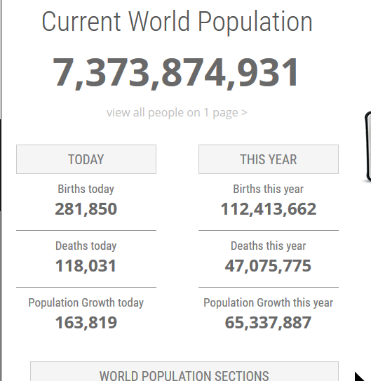
Population Size
World-o-Meter
Notes:
Ecosystems and Population Size
Activity:
Log on to World-o-Meters:
http://www.worldometers.info/world-population/
____

Slide 63
Research and Report
Notes:
Research and Report:
What is the carrying capacity of earth? Find information from three different sources.
_____

Slide 64
Time for Kahoot!
Notes:
Kahoot!
https://play.kahoot.it/#/k/bfda5296-0f76-4cef-9360-1dba0cb90532
_____

Slide 65
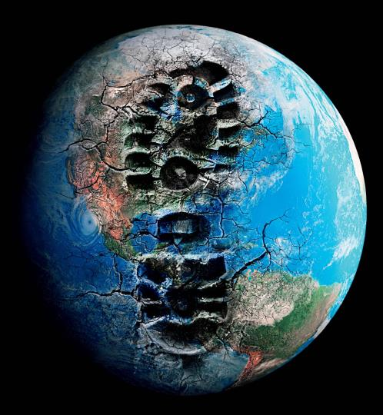
Human Impact
You can make a difference ☺
Ecological Footprint
Measures how fast we consume resources and generate waste compared to how fast nature can absorb our waste and generate new resources.
Notes:
Human Impact on Earth
As the Earth’s population grows, so do concerns about the impact the human population is making on its ecosystem. The estimated carrying capacity of the earth is based on our ecological footprint.
Ecological Footprint: Measures how fast we consume resources and generate waste compared to how fast nature can absorb our waste and generate new resources.
The good news is that we can change our ecological footprint, and it is changing. Global efforts are underway to change the negative the environmental impact we are making, like me, teaching this to you today. Human impact on the environment is now considered “critical content” to be presented in high school Biology, a required course by every student in the nation because the best way to make a change is to learn that we need one, and to learn how to make one.
_______

Slide 66
Human Impact
Trash
Let’s talk about trash!
Notes:
Human Impact on Earth
Let’s talk about trash!
_____

Slide 67
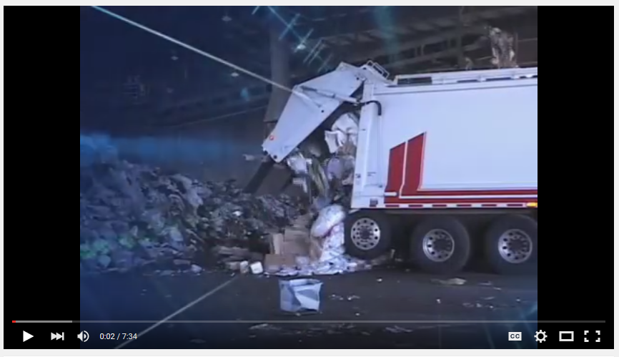
Human Impact
“A Day in the Life of Your Trash …”
Notes:
Human Impact on Earth
Landfill videos:
Show in Class: A Day in the life of your trash and recyclables, Where is Away? https://www.youtube.com/watch?v=TOpYa5OKGgY
_____

Slide 68
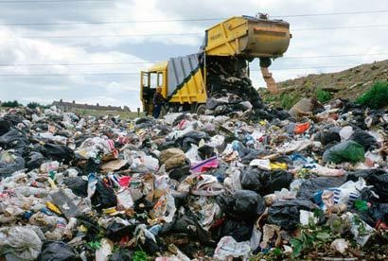
Human Impact
Trash
Americans
represent 5% of the world’s population, but generate 30% of the world’s garbage.
Notes:
Human Impact on Earth
Americans represent 5% of the world’s population, but generate 30% of the world’s garbage.
http://students.arch.utah.edu/courses/Arch4011/Recycling%20Facts1.pdf
_____

Slide 69
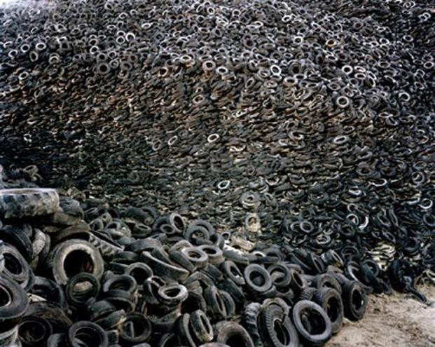
Human Impact
Trash
In a lifetime the average American will dispose of 90,000 pounds of trash.
Notes:
Human Impact on Earth
In the U.S. industry moves, mines, extracts, shovels, burns, wastes, pumps and disposes of 4 million pounds of material in order to provide one average middle-class American family’s needs for one year.
http://students.arch.utah.edu/courses/Arch4011/Recycling%20Facts1.pdf
_____

Slide 70
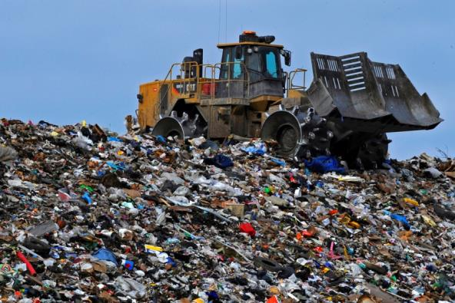
Human Impact
Trash
Years to Degrade in Landfill
Aluminum - 200 t0 500
Glass - 1,000,000
Plastic - up to 1,000
Notes:
Human Impact on Earth
Less than 2% of waste is recycled.
http://students.arch.utah.edu/courses/Arch4011/Recycling%20Facts1.pdf
_____

Slide 71
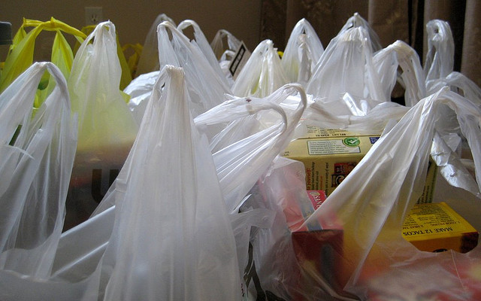
Human Impact
Trash
The oil it takes to make 14 plastic bags
would run your car for one mile. Also, Many blow away on their way to landfills and end up in our waterways.
Notes:
Human Impact on Earth
The amount of oil it takes to make 14 plastic retail bags would run your car for one mile. Also, Many blow away on their way to landfills and end up in our waterways.
http://www.fauquiercounty.gov/government/departments/environmental/index.cfm?action=why_recycle
_____

Slide 72
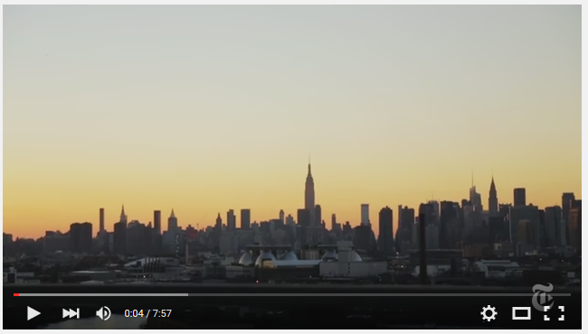
Human Impact
“New York Trash”
Notes:
Human Impact on Earth
Landfill videos:
Optional: New York Trash
https://www.youtube.com/watch?v=Y6LzB6rMDtA
_____

Slide 73
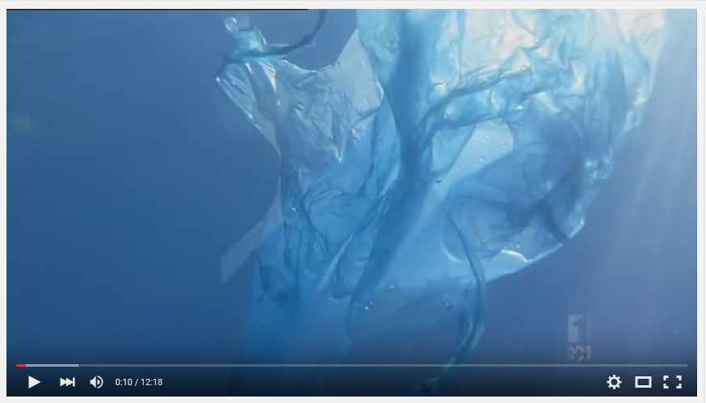
Human Impact
“Catalyst ABC TV - Plastic Oceans”
Videos
Notes:
Human Impact on Earth
Ocean Trash Videos:
Show in Class: Catalyst ABC Plastic Oceans
http://www.abc.net.au/catalyst/stories/3583576.htm
______

Slide 74
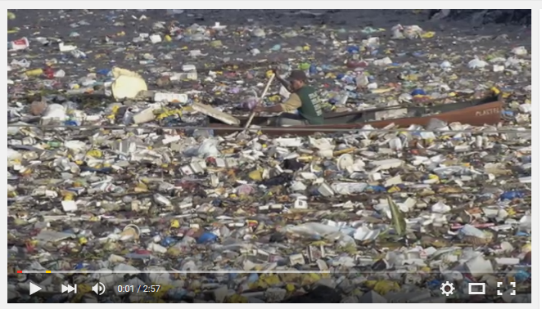
Human Impact
“Great Pacific Garbage Patch”
Notes:
Human Impact on Earth
Ocean Trash Videos:
Optional: Song with photos of plastic in ocean:
https://www.youtube.com/watch?v=1qT-rOXB6NI
____________

Slide 75
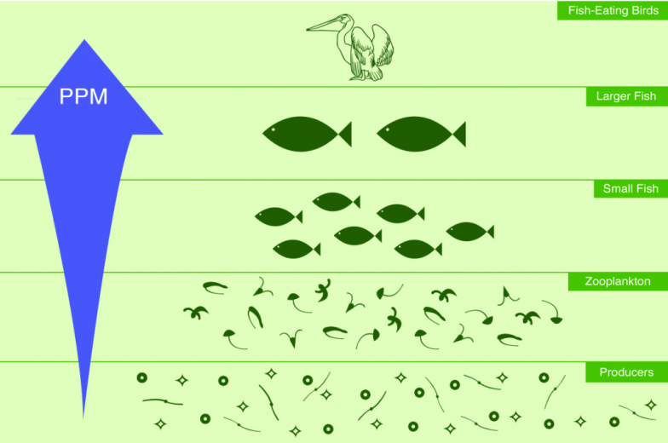
Biomagnification
Definition
Toxic substances become more concentrated as they move up the food chain.
Notes:
Human Impact on Earth
Biomagnification: Toxic substances become more concentrated as they move up the food chain. This can happen with pesticides applied to our fruits and vegetables, but is especially a problem in our waterways because we eat at the top trophic levels of ocean life.
_____

Slide 76
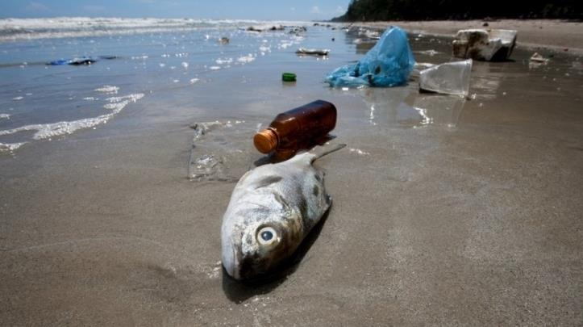
Biomagnification
Definition
Plastic contains chemicals called PCBs.
Plastic absorbs other chemicals in the ocean like a sponge.
Fish are eating plastic all the time.
Notes:
Human Impact on Earth
Biomagnification of Plastics and other Toxins:
Plastics aggravate biomagnification for these reasons:
Plastic contains chemicals called PCBs.
Plastic absorbs other chemicals in the ocean like a sponge.
Fish are eating plastic all the time.
Unsafe levels toxins has been detected in large fish which the FDA recommends we sparingly: http://www.fda.gov/food/resourcesforyou/consumers/ucm110591.htm
_____

Slide 77
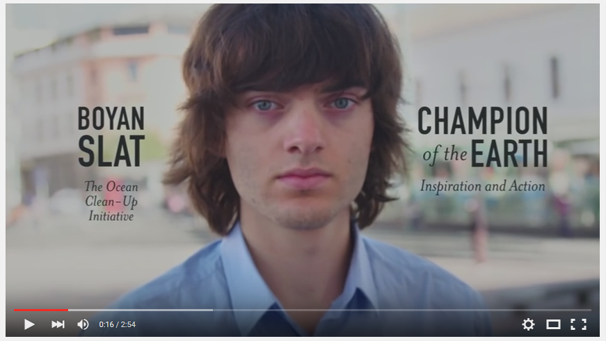
Human Impact
Boyan Slat, “Ocean Clean-up Initiative”
Notes:
Human Impact on Earth
Ocean Trash Videos:
Show in Class: Plastic in the Ocean - Boyan Slat (High School Student Changing the World)
https://www.youtube.com/watch?v=4IqsD-HAYwk
____________
Additional Videos:
Plastic in our oceans:
https://www.youtube.com/watch?v=Kd_QlauNmcw
Planet 100, the vortex explained:
https://www.youtube.com/watch?v=xc6LvdsyJ4U
Boyan Slat
www.businessinsider.com/teen-came-up-with-a-plan-to-clean-ocean-2016-2
_______

Slide 78
Human Impact
Trash
Less than 2% of waste is recycled.
Notes:
Human Impact on Earth
Less than 2% of waste is recycled.
http://students.arch.utah.edu/courses/Arch4011/Recycling%20Facts1.pdf
_____

Slide 79
Human Impact
Deforestation
Lets talk about trees!
Notes:
Human Impact on Earth
Let’s talk about trees!
_____

Slide 80
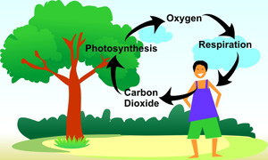
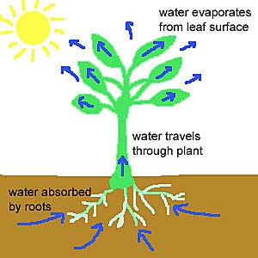
Human Impact
Deforestation
Trees are Important
Absorb CO2
Make oxygen
Return water to atmosphere through transpiration
Notes:
Human Impact on Earth
Deforestation
Trees are important. They absorb carbon dioxide, make oxygen and return water to the atmosphere through transpiration.
_____

Slide 81
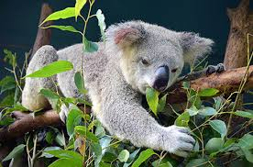
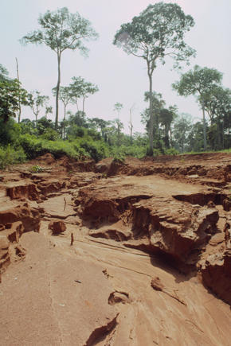
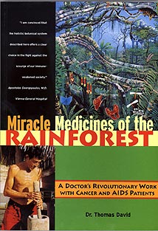
Human Impact
Deforestation
Trees are Important
Home to many species
Prevent soil erosion
Used for medicine
Notes:
Human Impact on Earth
Deforestation
Trees are important. They are home to many species, prevent soil erosion and are used for to make medicine.
_____

Slide 82
Human Impact
Deforestation
Deforestation is the permanent destruction of forests.
An estimated 18 million acres of forest are lost each year - United Nations’ Food and Agriculture Organization
Notes:
Human Impact on Earth
Deforestation
http://www.worldwildlife.org/threats/deforestation
_____

Slide 83
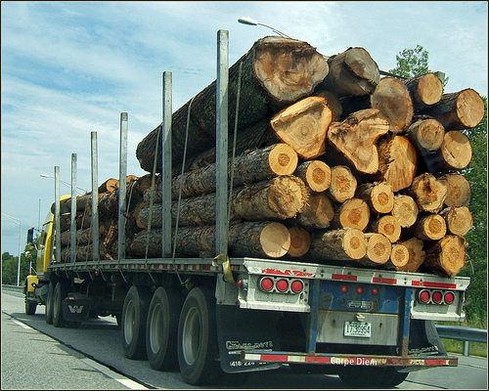
Human Impact
Deforestation
Every Sunday, 500,000 trees are used to produce
newspapers.
88% are never
recycled.
Notes:
Human Impact on Earth
Every Sunday, 500,000 trees are used to produce newspapers. 88% are never recycled.
http://students.arch.utah.edu/courses/Arch4011/Recycling%20Facts1.pdf
_____

Slide 84
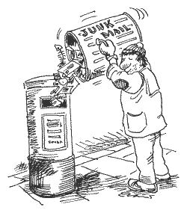
Human Impact
Deforestation
More than 100 million trees are destroyed each
year to produce
junk mail.
Notes:
Human Impact on Earth
Deforestation
More than 100 million trees are destroyed each year to produce junk mail.
https://www.41pounds.org/impact/
_____

Slide 85
Human Impact
Deforestation
United States
5% of Earth’s population
Uses 30% of the world’s paper
Notes:
Human Impact on Earth
Deforestation
More than 100 million trees are destroyed each year to produce junk mail.
https://www.41pounds.org/impact/
_____

Slide 86
CNN Explains Deforestation
Notes:
Video Shown in Class
CNN Report:
https://www.youtube.com/watch?v=M4jhjt1_eyM
_____

Slide 87
Amazonian Deforestation
Notes:
Video Shown in Class:
Amazonian Deforestation:
Note: Includes FSA Information and the -1 Font Project https://www.youtube.com/watch?v=wxy5k88IZiI
_____

Slide 88
Human Impact
Deforestation
Look for the FSC logo to ensure to are using paper products without compromising the health of the world’s forests.
Notes:
Human Impact on Earth
Deforestation
Look for the “Forest Stewardship Council” logo on products to ensure you are using paper products from forests without compromising the health of the world’s forests.
https://us.fsc.org/index.htm
_____

Slide 89
Human Impact
Acid Rain
Lets talk about
Acid Rain!
Notes:
Human Impact on Earth
Let’s talk about acid rain!
_____

Slide 90
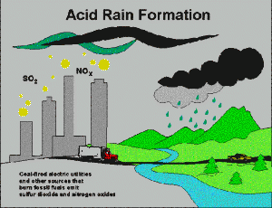
Human Impact
Acid Rain
Rain with a low pH level caused by pollution. Remember a low pH is acidic.
Notes:
Human Impact on Earth
Acid Rain
Acid rain is rain with a low PH level caused by pollution. Remember a low pH is acidic.
_____

Slide 91
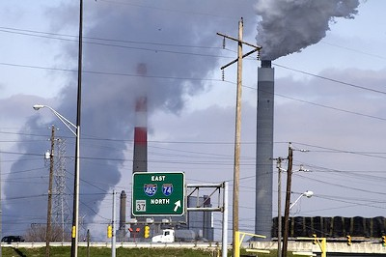
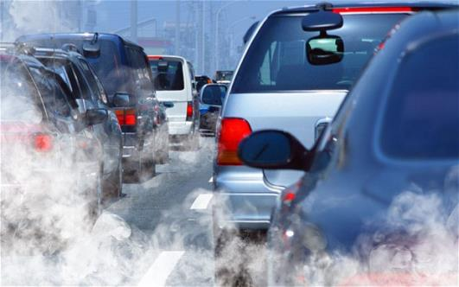
Human Impact
Acid Rain
Caused By
Burning fossil fuels like coal oil
Sulfur and nitrogen from these fuels combine with oxygen when burned and become acidic when mixed with water
An Indy Power Plant
Notes:
Human Impact on Earth
Acid Rain
More Information at: https://www3.epa.gov/region1/eco/acidrain/causes.html
_____

Slide 92
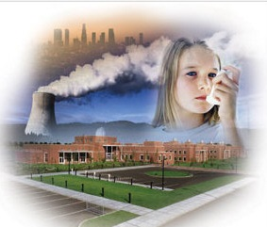
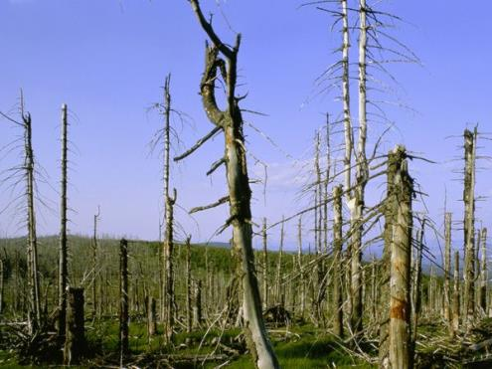
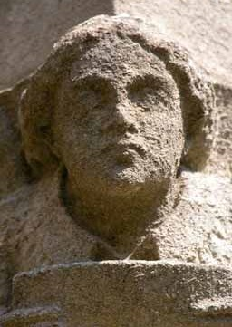
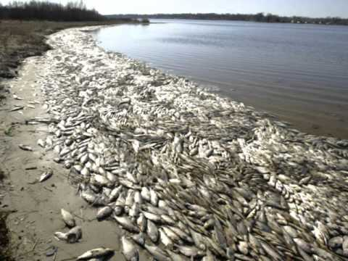
Human Impact
Acid Rain
Effects
Aggravated asthma
Erosion of monuments
Death of ocean life
Damage to trees
Notes:
Human Impact on Earth
Acid Rain
Acid rain is caused by burning “fossil fuels” such as coal to make electricity. It is also caused by the emission of exhaust from vehicles.
_____

Slide 93
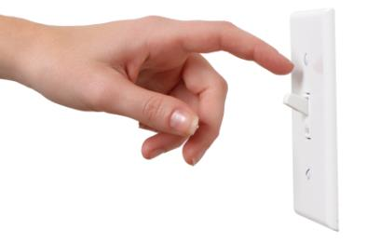
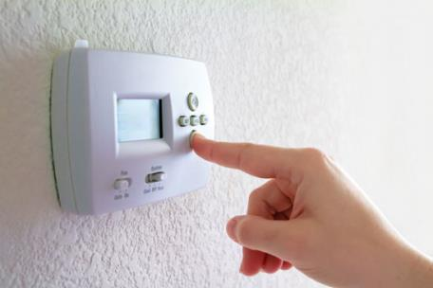
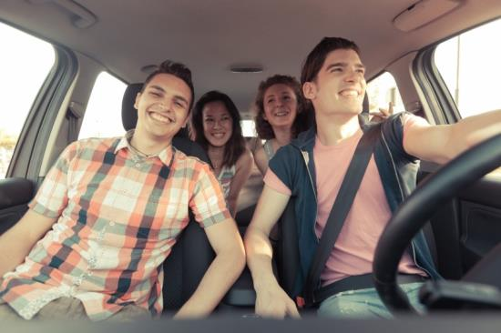
Human Impact
Acid Rain
What Can I Do?
Conserve electricity
Minimize miles driven
Notes:
Human Impact on Earth
Acid Rain
You can help by conserving electricity. Turn things off when not in use and adjust the thermostat. Carpool when you can.
_____

Slide 94
Human Impact
Eutrophication
Lets talk about
Eutrophication!
Notes:
Human Impact on Earth
Let’s talk about eutrophication!
_____
https://www.youtube.com/watch?v=ahOmeTOIrRg

Slide 95
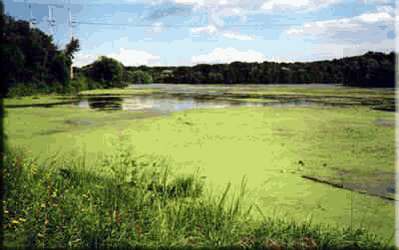
Human Impact
Eutrophication
Enrichment of an ecosystem with chemical nutrients, usually phosphorous and nitrogen.
Notes:
Human Impact on Earth
Eutrophication is the enrichment of an ecosystem with chemical nutrients, usually phosphorous and nitrogen.
_____
https://www.youtube.com/watch?v=ahOmeTOIrRg

Slide 96
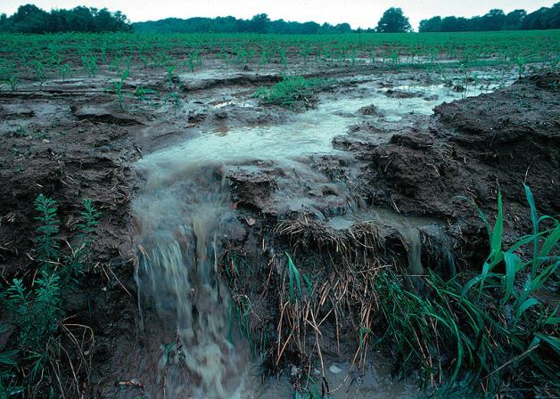
Human Impact
Eutrophication
Cause
Agricultural runoff
Phosphorous from cleaning products
Sewage runoff
Decay of leaves and plants
Notes:
Human Impact on Earth
Eutrophication is the enrichment of an ecosystem with chemical nutrients, usually phosphorous and nitrogen.
_____
https://www.youtube.com/watch?v=ahOmeTOIrRg

Slide 97
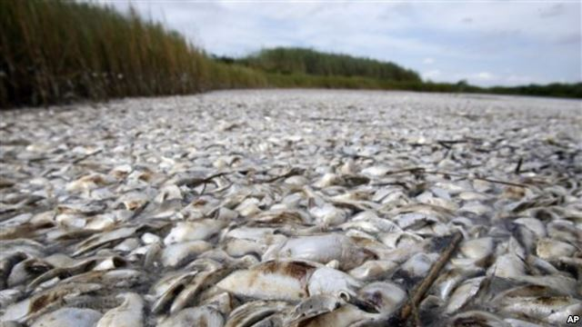
Human Impact
Eutrophication
Effects
Overproduction of algae
Dead zones
Death 0f aquatic life
Fish Kill, Louisiana Coast, 2010
Notes:
Human Impact on Earth
Effects of Eutrophication:
Overproduction of algae
Dead zones
Death of aquatic life
_____
https://www.youtube.com/watch?v=ahOmeTOIrRg

Slide 98
Dead Zones in the Gulf of Mexico
Notes:
Human Impact on Earth
Eutrophication
Video: https://www.youtube.com/watch?v=ahOmeTOIrRg
_____

Slide 99
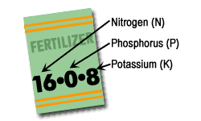
Human Impact
Eutrophication
What Can I Do?
Fertilize only if necessary
Choose phosphate free fertilizers
Choose organic
Notes:
Human Impact on Earth
Eutrophication
What Can I Do?
Fertilize only if necessary
Choose fertilizers that are phosphate free
Choose organic
_____

Slide 100
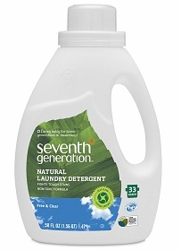
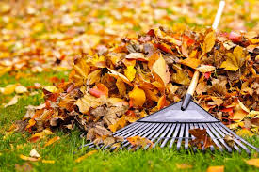
Human Impact
Eutrophication
What Can I Do?
Choose phosphate free detergents
Don’t leave lawn clipping in yard to decompose
Notes:
Human Impact on Earth
Eutrophication
What Can I Do?
Choose phosphate free detergents
Clean up animal waste promptly
Don’t leave lawn clippings in yard to decompose
_____

Slide 101
Human Impact
Agricultural Runoff
Lets talk about
Climate change!
Notes:
Human Impact on Earth
Let’s talk climate change!
Extra Climate Change Resources Not used in the Presentation:
Climate Change What it is and What We Cab Do:
https://www.youtube.com/watch?v=VTfgNFz1DBM
http://www3.epa.gov/climatechange/kids/basics/today/carbon-dioxide.html
11th Hour Video
https://www.youtube.com/watch?v=QvKWwer9_rg
One Day…
https://www.youtube.com/watch?v=8YQIaOldDU8
_______

Slide 102
Take AIM Climate Change Rap
Notes:
Human Impact on Earth
Rap: Aim at Climate Change
Video: https://www.youtube.com/watch?v=08z-Hw7s54E
_____

Slide 103
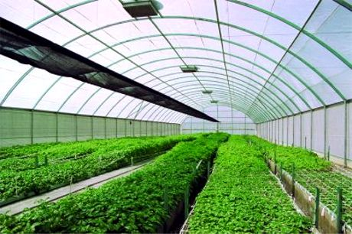
Human Impact
Climate Change
The earth is getting warmer due to heat-trapping gasses in the atmosphere known as greenhouse gasses.
Notes:
Human Impact on Earth
The earth is getting warmer due to heat-trapping gasses in the atmosphere know as greenhouse gasses.
_____

Slide 104
Human Impact
Greenhouse Gasses
Carbon dioxide - from fossil fuel combustion created by vehicle exhaust and by coal burned for electricity
Methane - from natural gas used for heat & from decaying organic matter in landfills
Nitrous oxide - from manufacturing plants and agricultural soil management
Notes:
Human Impact
Greenhouse Gasses
These are the most common greenhouse gasses:
Carbon dioxide from fossil fuel combustion created by vehicle exhaust and by coal burned for electricity
Methane from natural gas used for heat & from decaying organic matter in landfills
Nitrous oxide from manufacturing plants and agricultural soil management
_____

Slide 105
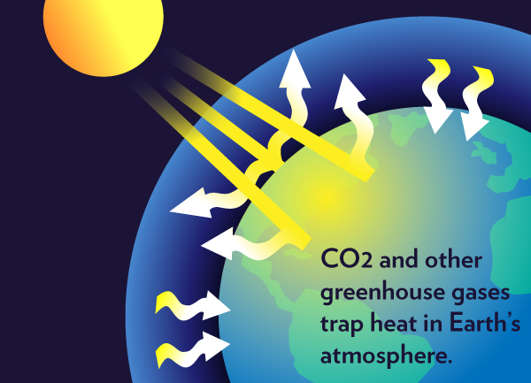
Human Impact
Climate Change
Greenhouse gasses trap heat in the Earth’s atmosphere causing global warming.
Notes:
Human Impact on Earth
Greenhouse Gasses
Trap heat in the Earth’s atmosphere causing global warming.
_____

Slide 106
Climate Change - The Lip TV
Notes:
Human Impact on Earth
2015: Climate Change - The Lip TV
Video: https://www.youtube.com/watch?v=STLe4O_OQPo
National Geographic: https://www.youtube.com/watch?v=pAA7FEqYTjA
____

Slide 107
Human Impact
Climate Change
Effects of Global Warming Nature.0rg
Make a Difference:
http://www3.epa.gov/climatechange/wycd/
Notes:
Human Impact on Earth
Note: Follow this hyperlink to read more about each effect:
http://www.nature.org/ourinitiatives/urgentissues/global-warming-climate-change/threats-impacts/
Follow this link to see how you can make a difference: http://www3.epa.gov/climatechange/wycd/
_____

Slide 108
Human Impact
Climate Change
Change Your Light Bulbs
If every U.S. family replaced one regular light bulb with a LED, it would eliminate 90 billion pounds of greenhouse gases, the same as taking 7.5 million cars off the road.
Notes:
Human Impact on Earth
Change Your Light Bulbs
If every U.S. family replaced one regular light bulb with a LED, it would eliminate 90 billion pounds of greenhouse gases, the same as taking 7.5 million cars off the road.
_____

Slide 109
Human Impact
Climate Change
Make a Difference:
http://www3.epa.gov/climatechange/wycd/
Notes:
Human Impact on Earth
Follow this link to see how you can make a difference: http://www3.epa.gov/climatechange/wycd/
_____

Slide 110
Human Impact
Sustainability
Lets talk about
Sustainability and Sustainable Resources!
Notes:
Human Impact on Earth
Let’s talk sustainable resources!
_____

Slide 111
Human Impact
Sustainability
Sustainability
Involving methods that do not completely use up or destroy natural resources.
Notes:
Human Impact on Earth
Sustainability: Involving methods that do not completely use up or destroy natural resources.
_____

Slide 112
Research and Report
Notes:
Research and Report:
In five minutes, write down as many examples of sustainable resources that you can find.
_____

Slide 113
11th Hour Clips - Sustainable Res
Notes:
Human Impact on Earth
Note for future use: This video only captured the attention of about half the students, however one student was so inspired he is thinking about this field of work now.
Video that inspires future environmentalists, clips from the 11th hour:
Video: https://www.youtube.com/watch?v=cPO_xnXvFKw
______

Slide 114
Non-Native Species Introduced
Asian Carp, Kudzu, Burmese Python
Notes:
Ecosystems and Changes in Community
Some important examples to remember: Asian carp, kudzu plant and the Burmese python
Video:
https://www.youtube.com/watch?v=mUssO68D2eM&list=PLbFNRAMu141STWDX3XtTG9k6_uviNj8dJ
_____

Slide 115
Introducing Non-native Species
Brings Consequences
Consequences
Can prey on native species causing a decrease in native species
May not have predators, so they can become overpopulated
Might be better predators, forcing native species out of their niche
Notes:
Ecosystems and Changes in Community
Introducing a non-native species can also upset the balance of an ecosystem.
Can prey on native species causing a decrease in native species
May not have predators, so they can become overpopulated
Might be better predator, forcing native species out of their niche
_____

Slide 116
References
References are in the slide notes for this presentation
Notes:
References are in the slide notes for this presentation.

