Slide 1
Evolution Unit

Slide 2
The Theory of Evolution
The theory of evolution is a theory about how living things evolved from simple to more complex forms over time.

Slide 3
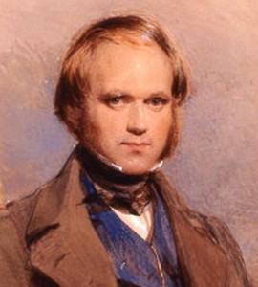
Charles Darwin
& Natural Selection
Charles Darwin is known as “The Father of Evolution” because he proposed the idea of “Natural Selection” as a mechanism or way for species to evolve or change over time, supporting the idea that all life might have evolved from a common ancestor.

Slide 4
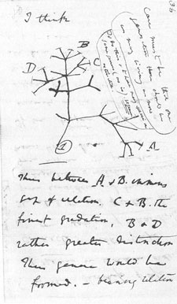
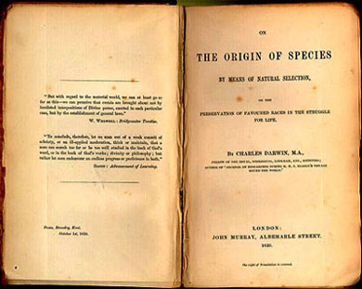
Charles Darwin
& Natural Selection

Slide 5
Charles Darwin
& Natural Selection
Natural Selection is the process by which organisms that can adapt to changes in their environment are able to survive, reproduce and pass on their genetic material.
Notes:
VOCABULARY
Natural Selection: The process by which plants and animals that can adapt to changes in their environment are able to survive and reproduce while those that cannot adapt do not survive.
Photo: http://study.com/academy/lesson/who-was-charles-darwin-theory-of-evolution-natural-selection-quiz.html
_____

Slide 6
4 Principles
of Natural Selection
Variation
There must be variation within a population that that is hereditable.
Notes:
4 Principles of Natural Selection

Slide 7
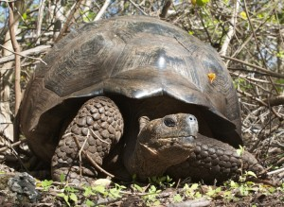
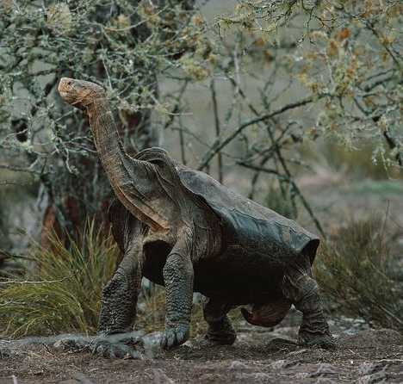
Charles Darwin
& Natural Selection
Variation is difference within a population

Slide 8
4 Principles
of Natural Selection
Adaptation
There must be a certain variation of a trait that allows an individual to survive when it competes against the environment.
Notes:
4 Principles of Natural Selection

Slide 9
Charles Darwin
& Natural Selection
An adaptation allows an organism to survive in its environment.

Slide 10
4 Principles
of Natural Selection
Overproduction
There must be an overproduction of offspring resulting in competition for resources.
Notes:
4 Principles of Natural Selection

Slide 11
4 Principles
of Natural Selection
Descent with Modification
There must be a continual modification of decedents with adaptations suited for their environment.
Notes:
4 Principles of Natural Selection

Slide 12
Charles Darwin
& Natural Selection
Variation among species matched environmental conditions.
Isabella Island Tortoise
Notes:
Variation Among Species - Tortoises
Darwin also found a variation among species that seemed to be connected to the environments they lived in.
The tortoises of Isabella Island, where vegetation was abundant and close to the ground, had dome-shaped shells with short necks.
Photo: http://biome.biomedcentral.com/island-evolution-exploring-the-population-genomics-of-the-giant-galapagos-tortoise/
_____

Slide 13
Charles Darwin
& Natural Selection
Variation among species matched environmental conditions.
Hood Island Tortoise
Notes:
Variation Among Species - Tortoises
While the tortoises of Hood Island had very long necks with a hump on their shell allowing necks to reach to very high places. Can you guess where the most abundant vegetation was found on Hood Island? It was not on the ground, hood island tortoises’ main source of food is found in high areas such as shrubbery and bush.
Photo: http://biome.biomedcentral.com/island-evolution-exploring-the-population-genomics-of-the-giant-galapagos-tortoise/
_____

Slide 14
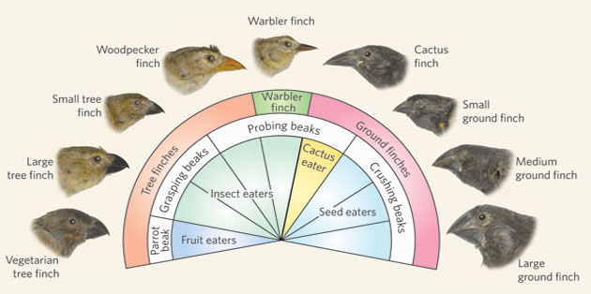
Charles Darwin
& Natural Selection
Finches of the Galapagos Islands
Notes:
Variation Among Species - Finches
Darwin found variation among the finches at the Galapagos Islands too. Each adapted to the environment of the island it inhabited.
Photo: https://www.stormfront.org/forum/t1039853/
_____

Slide 15
Example of Natural Selection Acting on a Population
Notes:
This is an example of Natural Selection acting on a population causing it to evolve.

Slide 16
Notes:
It is a story about the evolution of a moth population in Brittain. It took place during the 19th century. During that time, most peppered moths were light in color. A few were dark. Do you see the light moth on the right side of the photo?

Slide 17
Notes:
The population of peppered moths included a much higher percentage of the light phenotype because they were able to camouflage themselves from predators on tree bark.

Slide 18
Notes:
Birds flying over the trees didn’t see the light moths. Can you see it?

Slide 20
Notes:
So they picked off the dark moths.

Slide 22
Notes:
During this time, industry began to boom. This period was called the “Industrial Revolution”. Pollution was not controlled at that time because it’s negative effects on the environment were not yet understood.

Slide 23
Notes:
Smoke stacks pumped thick black smoke into the atmosphere.

Slide 24
Notes:
Over time the black smoke covered the light bark on surrounding trees causing something very unexpected to happen to the moth population.

Slide 25
Notes:
The light covered moths were no longer camouflaged by the light tree bark and were heavily preyed upon. Meanwhile, the dark peppered moths enjoyed the safety of the darkened bark now camouflaging the dark population of moths.

Slide 26
Notes:
As predators continued to feast on the light moths, the dark moths multiplied.

Slide 28
Notes:
And multiplied.

Slide 30
Notes:
And the white moths became more scarce.

Slide 31
Notes:
This is an example of the evolution of a population through natural selection.

Slide 33
What was the Variation in the Moth Population?
?

Slide 34
What was the Adaptation in the Moth Population?
?

Slide 35
What resource was limited Due to Overproduction?
?

Slide 36
How were the Decedents Modified?
?
Notes:
What was the Adaptation in the moth population?
_____

Slide 37
Moth Population When Pollution Was Controlled?
?
What Happened to the
Notes:
Scientific Discourse
What happened to the moth population when pollution was controlled and the smoke went away?
_____

Slide 38
If the pollution problem was worldwide.
?
Predict what would have happened…
Notes:
Scientific Discourse
Predict what would have happened to peppered moths if the pollution problem was worldwide and remained uncontrolled.
_____

Slide 39
Let’s Explore Evolution
Digital Activities
Notes:
Lab
Refer to your work packets for lab instructions.
_____

Slide 40
Origin of Life & Evidence of Ev
Notes:
Part 1
Origin of Earth and Life
_____

Slide 41
How did something living (organic) arise from non-living matter? (inorganic)
?
Notes:
Spontaneous Generation
How did something living (organic), arise from non-living matter (inorganic)?
Draw from Previous Knowledge:
Fransesco Redi proved this is impossible when he placed meat in a sealed jar preventing flies to lay eggs that could have hatched into maggots.
Louis Pasture proved this is impossible when he kept bacteria out of broth using a long neck flask.
Scientists believe that the atmosphere was much different 4.5 billion years ago, and that even though spontaneous generation is impossible today, the conditions at that time allowed it.
Do you know what amino acids are? They are the building blocks of proteins, one of the four macromolecules that make up living things. That’s important to know to understand the two hypothesis that follow.
_____

Slide 42
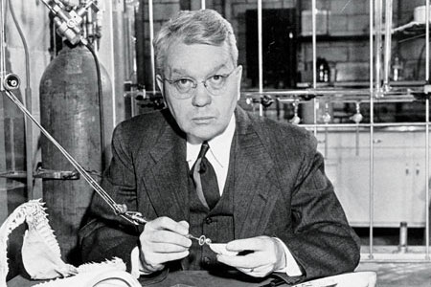
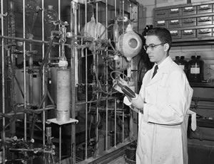
Miller-Urey Experiment
Organic Molecules from Inorganic Molecules
Harold Urey
http://pubs.acs.org/cen/priestley/recipients/1973urey.html
Stanley Miller
http://www.astrobio.net/topic/origins/origin-and-evolution-of-life/life-of-an-origins-pioneer/
Notes:
Organic Molecule Hypothesis One: Miller-Urey Experiment
Scientists Harold Urey and Stanley Miller put the idea of spontaneous generation to the test.
Harold Urey was a Chemistry professor at the University of Chicago, and Stanley Miller was one of his students. This is a picture of them in their college science lab working on the new famous “Miller-Urey Experiment”. Many important discoveries have been made in University Laboratories!
In 1952, Miller and Urey tested a hypothesis made in the 1920’s that the atmosphere of the primitive earth was comprised of gasses that could in fact give rise to organic molecules if supplied with a source of electricity such as lightning or ultra violet radiation from the sun.
_____

Slide 43
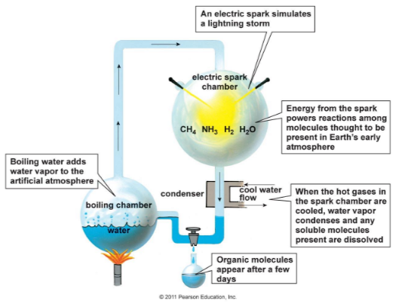

Slide 44
Meteorite Hypothesis
In 1969 a meteorite crashed into Murchison, Australia. Scientists found the meteorite contained over 90 amino acids, 19 of which have been found on Earth, remember all of life is made up of 20 amino acids. This resulted in the “Murchison Hypothesis” that life may have originated from amino acids in a meteorite.

Slide 45
The Primordial Soup hypothesis suggests that life began in a body of water as a result of the combination of chemicals from the atmosphere and some form of energy to make amino acids, the building blocks of proteins, which would then evolve into the first life on Earth.
The Primordial Soup hypothesis suggests that life began in a body of water as a result of the combination of chemicals from the atmosphere and some form of energy to make amino acids, the building blocks of proteins, which would then evolve into the first life on Earth.
Primordial Soup Hypothesis
The Primordial Soup hypothesis suggests that life began in a body of water as a result of the combination of chemicals from the atmosphere and some form of energy to make amino acids, the building blocks of proteins, which would then evolve into the first life on Earth.

Slide 46
The Primordial Soup hypothesis suggests that life began in a body of water as a result of the combination of chemicals from the atmosphere and some form of energy to make amino acids, the building blocks of proteins, which would then evolve into the first life on Earth.
The Primordial Soup hypothesis suggests that life began in a body of water as a result of the combination of chemicals from the atmosphere and some form of energy to make amino acids, the building blocks of proteins, which would then evolve into the first life on Earth.
Deep Sea Vent Hypothesis
The deep-sea vent hypothesis suggests that life may have begun deep within the ocean where deep sea vents spewed key hydrogen-rich molecules. Their rocky nooks could then have concentrated these molecules together and provided mineral catalysts for critical reactions.

Slide 47
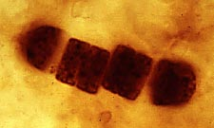
First Life on Earth
Fossil Record
Cyanobacteria are single-celled prokaryotes thought to be the first living organisms on Earth.
The fossil record estimates they were in existence
4 billion years ago.

Slide 48
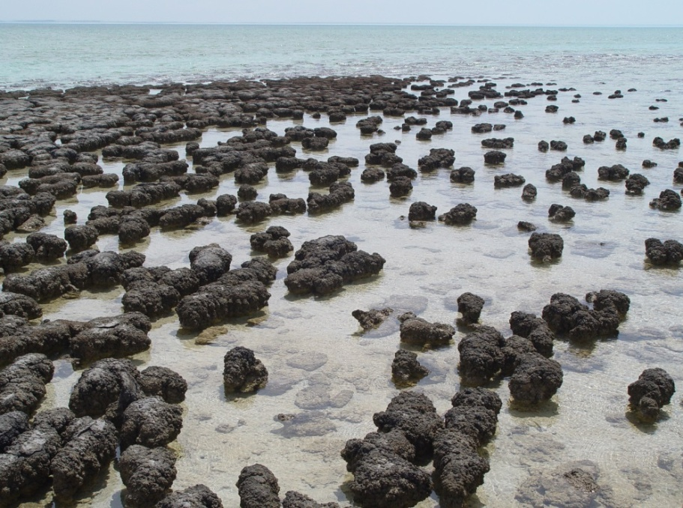
Earth’s Atmosphere Oxygenated
Bacteria formed Stromatolites
Released oxygen through photosynthesis creating an atmosphere in which life could survive
Shark Bay Australia
Notes:
Cyanobacteria Change Earth’s Composition
Colonies of cyanobacteria form stromatolites which are mounds of sediment and living bacteria. This is a picture of stromatolites in Shark Bay Australia. Scientists believe colonies of these stromatolites changed the physical composition of the earth, and the chemical composition by releasing vast amounts of oxygen as a by-product of photosynthesis.
Photo: http://www.google.com/imgres?imgurl=http://upload.wikimedia.org/wikipedia/commons/1/1b/Stromatolites_in_Sharkbay.jpg&imgrefurl=http://en.wikipedia.org/wiki/Stromatolite&h=1816&w=2440&tbnid=PpbrGInhlnHLHM:&zoom=1&tbnh=160&tbnw=214&usg=__e21_fBg8WHN7vkFdOlIOyXtzxe8=&docid=aB_zoNEVPcF2aM&itg=1
______

Slide 49
How did a multicellular organism arise from a single-celled organism?
?
Notes:
Scientific Discourse
How did a multicellular organism arise from a single-celled organism?
_____

Slide 50
The Primordial Soup hypothesis suggests that life began in a body of water as a result of the combination of chemicals from the atmosphere and some form of energy to make amino acids, the building blocks of proteins, which would then evolve into the first life on Earth.
The Primordial Soup hypothesis suggests that life began in a body of water as a result of the combination of chemicals from the atmosphere and some form of energy to make amino acids, the building blocks of proteins, which would then evolve into the first life on Earth.
Origin of Life
Endosymbiotic Theory
Endosymbiotic Theory suggests that eukaryotes were formed when prokaryotes were engulfed (or swallowed up) by larger prokaryotes and somehow survived instead of being digested. Some scientists believe that chloroplasts and mitochondria were formerly prokaryotes.

Slide 51
Origin of Life
Endosymbiotic Theory
Notes:
Endosymbiotic Theory
Endosymbiotic Theory suggests that eukaryotes were formed when prokaryotes were engulfed by larger prokaryotes and somehow survived instead of being digested. Some scientists believe that chloroplasts and mitochondria were formerly prokaryotes. This theory is based on several factors. Unlike other organelles, chloroplasts and mitochondria have their own DNA and ribosomes. They can make copies of themselves, they are about the same size as prokaryotes, and they have circular DNA similar to that of bacteria.
Photo: http://www.ib.bioninja.com.au/options/option-d-evolution-2/d1-origins-of-life-on-earth.html
______

Slide 52
Early prokaryotes and eukaryotes reproduced asexually, so… How can there be genetic diversity among organisms today?
?
Notes:
Scientific Discourse
Early prokaryotes are eukaryotes reproduced asexually, so how can there be genetic diversity among organisms today?
_____

Slide 53
The area of sexual reproduction is still an area of scientific research.
?
Notes:
_____

Slide 54
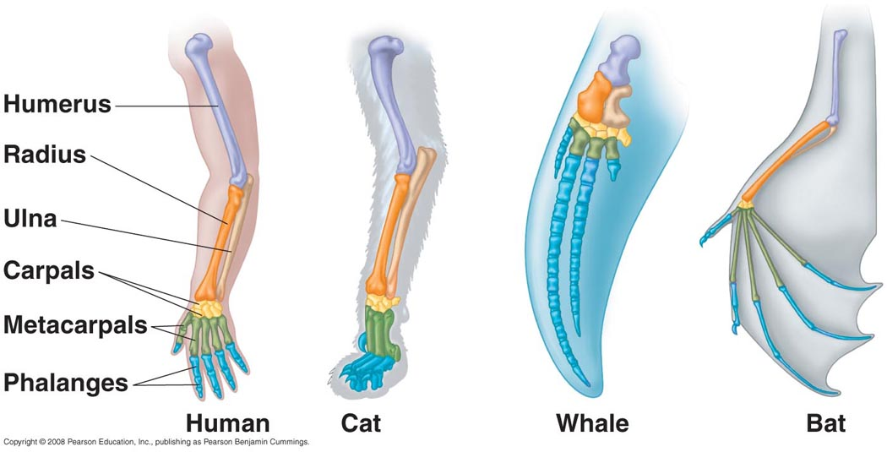
Homologous Structures
Suggest Recent Ancestry
Homologous structures have the same bones suggesting recent common ancestors.
Notes:
Anatomy is the study of the structure of organisms, is also used as evidence for evolution.
VOCABULARY
Homologous Structures: Similar in structure but appear in different organisms and have different functions.
Scientists believe that common structures, called “homologous structures”, in organisms show common ancestry. They say it is unlikely for the structures in species to be arranged in such a similar way if they evolved independently.
Label the diagram in your work packet.
Photo: http://www.bio.miami.edu/dana/106/106F05_4.html
____

Slide 55
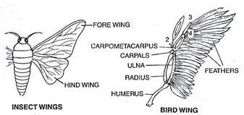
Analogous Structures
Suggest Convergent Evolution
Process whereby organisms that are not closely related independently evolve similar traits as a result of having to adapt to similar environments.
Notes:
VOCABULARY
Analogous Structures: Perform similar functions, but are not similar in origin.
Structures that are not common in structure, but common in function, called “analogous structures” suggest that over time unrelated species may have adapted to their environments.
Photo: http://www.yourarticlelibrary.com/biology/organic-evolution-9-main-evidences-of-organic-evolution/13238/
____

Slide 56
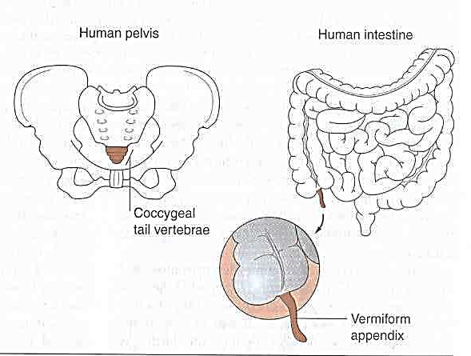
Vestigial Structures
Remnants of
an organ, no longer used, that
had a function
in an earlier ancestor.
Notes:
VOCABULARY
Vestigial Structures: Remnants of an organ that had a function in an earlier ancestor
Structures that have no apparent function today, called “vestigial structures”, may have been used for an original purpose in an ancestor.
Photo: http://goose.ycp.edu/~kkleiner/EvolBio/EvolBioImages/EvidenceforEvol/VestigialStructures.jpg
____

Slide 57
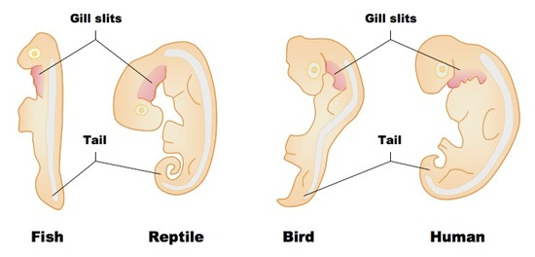
Embryology
Similarities in embryonic development
suggest common ancestry.
Notes:
VOCABULARY
Embryology: Study of the embryo from the time of fertilization until it reaches the fetus stage.
Scientists have found many similarities between organisms in the embryotic stage. Refer to your work packet for a closer view of this illustration.
Photo: http://www.vce.bioninja.com.au/aos-4-change-over-time/evolution/evidence-for-evolution.html
____

Slide 58
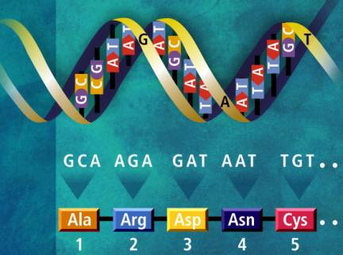
Molecular Biology
Study of living things at the molecular level such as DNA, RNA and proteins. This is useful in determining how closely related ancestors may be.
Notes:
VOCABULARY
Molecular Biology: Study of living things at the molecular level such as DNA, RNA and proteins
Today scientists are able to compare the amino acid sequences in proteins to find similarities among species.
Background: DNA is transcribed into RNA. RNA codes for amino acids that build proteins.
Photo: http://science.howstuffworks.com/life/cellular-microscopic/dna4.htm
____

Slide 59
Amino Acid Sequencing
Molecular Biology
Amino Acid | 4 | 5 | 6 | 9 | 10 | 12 | 13 | 20 | 25 | 33 | 41 | 43 | 50 | 51 | 52
Human | T | P | E | S | A | T | A | V | G | V | F | E | T | P | D
Bear | T | G | E | S | L | T | G | V | G | V | F | D | S | A | D
Chimpanzee | T | P | E | S | A | T | A | V | G | V | F | E | T | P | D
Gibbon | T | P | E | S | A | T | A | V | G | V | F | E | T | P | D
Gorilla | T | P | E | S | A | T | A | V | G | V | F | E | T | P | D
Monkey | T | P | E | N | A | T | T | V | G | L | F | E | S | P | D
Mouse | T | D | A | A | A | S | C | S | G | V | Y | D | S | A | S
Shrew | S | G | E | A | C | T | G | E | A | V | F | D | S | A | S
Amino Acid Sequencing Chart
Notes:
Molecular Biology Amino Acid Sequencing
Refer to this chart in your packet.
____

Slide 60
Amino Acid Sequencing
Molecular Biology
Location | 4 | 5 | 6 | 9 | 10 | 12 | 13 | 20 | 25 | 33 | 41 | 43 | 50 | 51 | 52
Human | T | P | E | S | A | T | A | V | G | V | F | E | T | P | D
Bear | T | G | E | S | L | T | G | V | G | V | F | D | S | A | D
Chimpanzee | T | P | E | S | A | T | A | V | G | V | F | E | T | P | D
Gibbon | T | P | E | S | A | T | A | V | G | V | F | E | T | P | D
Gorilla | T | P | E | S | A | T | A | V | G | V | F | E | T | P | D
Monkey | T | P | E | N | A | T | T | V | G | L | F | E | S | P | D
Mouse | T | D | A | A | A | S | C | S | G | V | Y | D | S | A | S
Shrew | S | G | E | A | C | T | G | E | A | V | F | D | S | A | S
This Chart Compares Eight Organisms
Notes:
Molecular Biology Amino Acid Sequencing
This is a chart of amino acid sequences for eight mammals.
____

Slide 61
Amino Acid Sequencing
Molecular Biology
Location | 4 | 5 | 6 | 9 | 10 | 12 | 13 | 20 | 25 | 33 | 41 | 43 | 50 | 51 | 52
Human | T | P | E | S | A | T | A | V | G | V | F | E | T | P | D
Bear | T | G | E | S | L | T | G | V | G | V | F | D | S | A | D
Chimpanzee | T | P | E | S | A | T | A | V | G | V | F | E | T | P | D
Gibbon | T | P | E | S | A | T | A | V | G | V | F | E | T | P | D
Gorilla | T | P | E | S | A | T | A | V | G | V | F | E | T | P | D
Monkey | T | P | E | N | A | T | T | V | G | L | F | E | S | P | D
Mouse | T | D | A | A | A | S | C | S | G | V | Y | D | S | A | S
Shrew | S | G | E | A | C | T | G | E | A | V | F | D | S | A | S
These Letters Represent the 20 Amino Acids
Notes:
Molecular Biology Amino Acid Sequencing
Each letter stands for a different amino acid.
____

Slide 62
Amino Acid Sequencing
Molecular Biology
Location | 4 | 5 | 6 | 9 | 10 | 12 | 13 | 20 | 25 | 33 | 41 | 43 | 50 | 51 | 52
Human | T | P | E | S | A | T | A | V | G | V | F | E | T | P | D
Bear | T | G | E | S | L | T | G | V | G | V | F | D | S | A | D
Chimpanzee | T | P | E | S | A | T | A | V | G | V | F | E | T | P | D
Gibbon | T | P | E | S | A | T | A | V | G | V | F | E | T | P | D
Gorilla | T | P | E | S | A | T | A | V | G | V | F | E | T | P | D
Monkey | T | P | E | N | A | T | T | V | G | L | F | E | S | P | D
Mouse | T | D | A | A | A | S | C | S | G | V | Y | D | S | A | S
Shrew | S | G | E | A | C | T | G | E | A | V | F | D | S | A | S
These Numbers Indicate the Location of Each Amino Acid on the Protein Strand
Notes:
Molecular Biology Amino Acid Sequencing
Each column is a location on the protein chain.
Locations where the amino acids are identical in all eight mammals are not shown.
____

Slide 63
Amino Acid Sequencing
Molecular Biology
Location | 4 | 5 | 6 | 9 | 10 | 12 | 13 | 20 | 25 | 33 | 41 | 43 | 50 | 51 | 52
Human | T | P | E | S | A | T | A | V | G | V | F | E | T | P | D
Bear | T | G | E | S | L | T | G | V | G | V | F | D | S | A | D
Chimpanzee | T | P | E | S | A | T | A | V | G | V | F | E | T | P | D
Gibbon | T | P | E | S | A | T | A | V | G | V | F | E | T | P | D
Gorilla | T | P | E | S | A | T | A | V | G | V | F | E | T | P | D
Monkey | T | P | E | N | A | T | T | V | G | L | F | E | S | P | D
Mouse | T | D | A | A | A | S | C | S | G | V | Y | D | S | A | S
Shrew | S | G | E | A | C | T | G | E | A | V | F | D | S | A | S
Compare the Amino Acid Sequences of the Animals to Humans
Notes:
Molecular Biology Amino Acid Sequencing
Instructions: Compare the amino acid sequences between seven animals and the human. Circle any amino acid that is different than that of a human. Record data in the table below the Amino Acid sequencing chart.
____

Slide 64
Classification of Life
Notes:
Part 3: Classification of Life
Classification of Life is the last section in our study of evolution.
_____

Slide 65
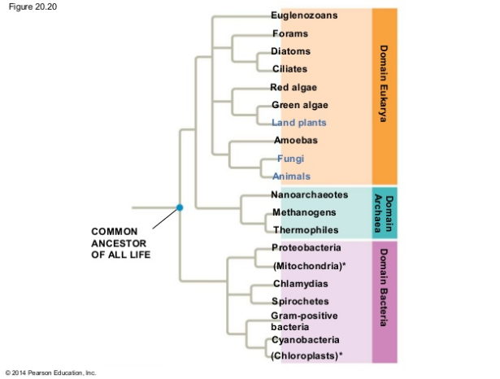
Three
Domains

Slide 66
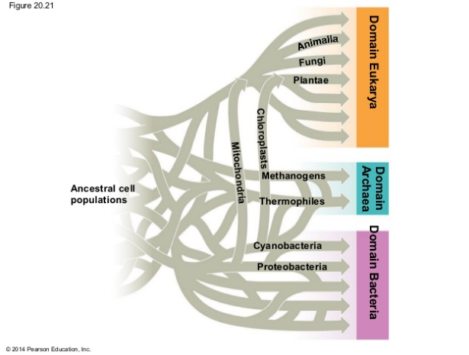
Find the Chloroplast and Mitochondria. What does this diagram illustrate?
Three
Domains

Slide 67
Find the Chloroplast and Mitochondria. What does this diagram illustrate?
Answer:
The Endosymbiotic Theory
Three
Domains

Slide 68
Cladograms (7:18) BozemanScience.com
Notes:
Video ReCap
This video breaks down how a cladogram is made.
Video html address: http://www.bozemanscience.com/cladograms
_____

Slide 69
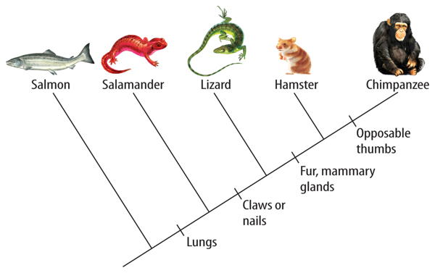
Cladistics
Classification on a Cladogram
Cladistics is the process of classifying organisms based on common
Ancestry on a cladogram.
Notes:
VOCABULARY
Phylogenies can be shown through branching tree diagrams. Each branch represents a species or taxon. The most common way to show phylogeny is through the method of cladistics. Cladistics is classification based on common ancestry.
Photo: http://schoolworkhelper.net/evolution-synapomorphies-cladogram/
_____

Slide 70
Cladistics
Classification on a Cladogram
Each species branches out to
a new clade on
the cladogram.
Notes:
VOCABULARY
Each species branches out to a new clade on the cladogram.
Photo: http://schoolworkhelper.net/evolution-synapomorphies-cladogram/
_____

Slide 71
Cladistics
Classification on a Cladogram
Derived characters are traits that differ
in structure or function than
traits found in ancestral line for
a group of species.
Notes:
VOCABULARY
Derived characters are traits that can be used to determine relationships between species.
Photo: http://schoolworkhelper.net/evolution-synapomorphies-cladogram/
_____

Slide 72
Cladistics
Classification on a Cladogram
Each place the branch splits is called a node. Nodes represent most common ancestors.
Notes:
VOCABULARY
Photo: http://schoolworkhelper.net/evolution-synapomorphies-cladogram/
_____

Slide 73
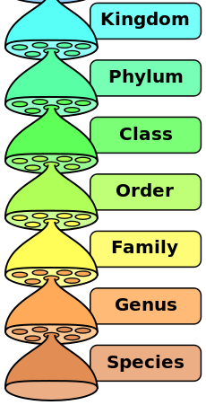
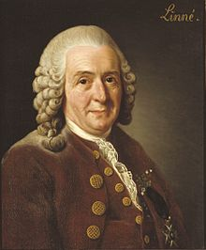
Linnaean System
Based on Physical Characteristics
Carolus Linnaeus
Notes:
Linnaean System
The first classification system was designed by Carolus Linnaeus in the 1750’s. At that time scientists were making discoveries worldwide and in many cases naming organisms with their own last name to mark their findings. Linnaeus recognized the importance of developing a system to name and organize all living things with a naming system that crossed language barriers.
Photo: http://www.csus.edu/indiv/l/loom/lecture_3_notes.htm
Photo: https://en.wikipedia.org/wiki/File:Biological_classification_L_Pengo_vflip.svg
Photo: https://en.wikipedia.org/?title=Carl_Linnaeus
_____

Slide 74
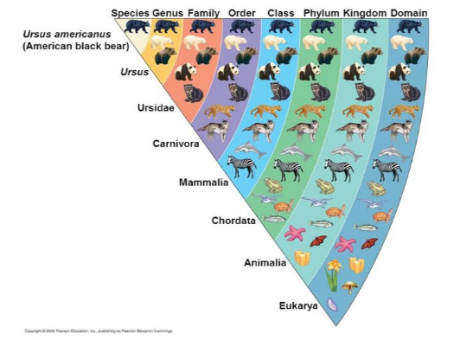
Vocabulary
Taxonomy
The science
of classifying
and naming organisms.
Notes:
VOCABULARY
Taxonomy is the science of classifying and naming organisms according to their physical characteristics.
Photos: http://www.csus.edu/indiv/l/loom/lecture_3_notes.htm
_____

Slide 75
Vocabulary
Taxon
Each group
within the Linnaean classification system
(plural = taxa).
Notes:
VOCABULARY
The Linnaean System is organized in seven categories called “taxon”. The Kingdom taxon is the most broad, and the species is the most specific, based on physical characteristics.
Let’s review this taxa of the moss rose.
Note: Review all seven taxa.
Photos: http://www.csus.edu/indiv/l/loom/lecture_3_notes.htm
_____

Slide 76
Linnaean System
Based on Physical Characteristics
Notes:
Linnaean System
It is important that you are familiar with the order of the system (Kingdom to Species).
Clever saying to remember the order: “King Phillip came over for good spaghetti”
Photo: http://www.csus.edu/indiv/l/loom/lecture_3_notes.htm
Photo: https://en.wikipedia.org/wiki/File:Biological_classification_L_Pengo_vflip.svg
_____

Slide 77
Vocabulary
Binomial Nomenclature
The first part of the name is the “genus”.
Rule: Always capitalized and written in italics.
Notes:
VOCABULARY
Charles Linnaeus also developed a two part naming system known as, “Binomial Nomenclature”. This system gives each species a two-part scientific name using Latin words. This naming system ensures that all scientists are using the same terms when discussing an organism. The first part of the name is the “genus”. It includes species that are closely related.
Rule: The Genus is always capitalized.
Photos: http://www.csus.edu/indiv/l/loom/lecture_3_notes.htm
_____

Slide 78
Vocabulary
Binomial Nomenclature
The second part of the name is the “species”. Rule: always lower case and in italics.
Notes:
VOCABULARY
The second part of the name is the species. The species describes the species. It is written in lower case. There is only one species in the species taxon.
Rule: Both the Genus and species are written in italics.
Photos: http://www.csus.edu/indiv/l/loom/lecture_3_notes.htm
_____

Slide 79
1. Homo Sapien
2. Homo sapien
3. homo sapien
4. Homo Sapien
5. Homo sapien
6. homo sapien

